Slide 1
N.C.S.A BUSINESS MEETING/
AWARDS DINNER - 2018

Slide 2
Agenda
Election Starts
Marianne discusses WSPA
Member Achievements & Milestones
OLC Numbers
Awards and Recognitions
Election Results
Ramy Yanetz – after dinner speech
Close of Meeting

Slide 3
Member Achievements and Milestones in 2017
Numbers
Awards and Recognition

Slide 4
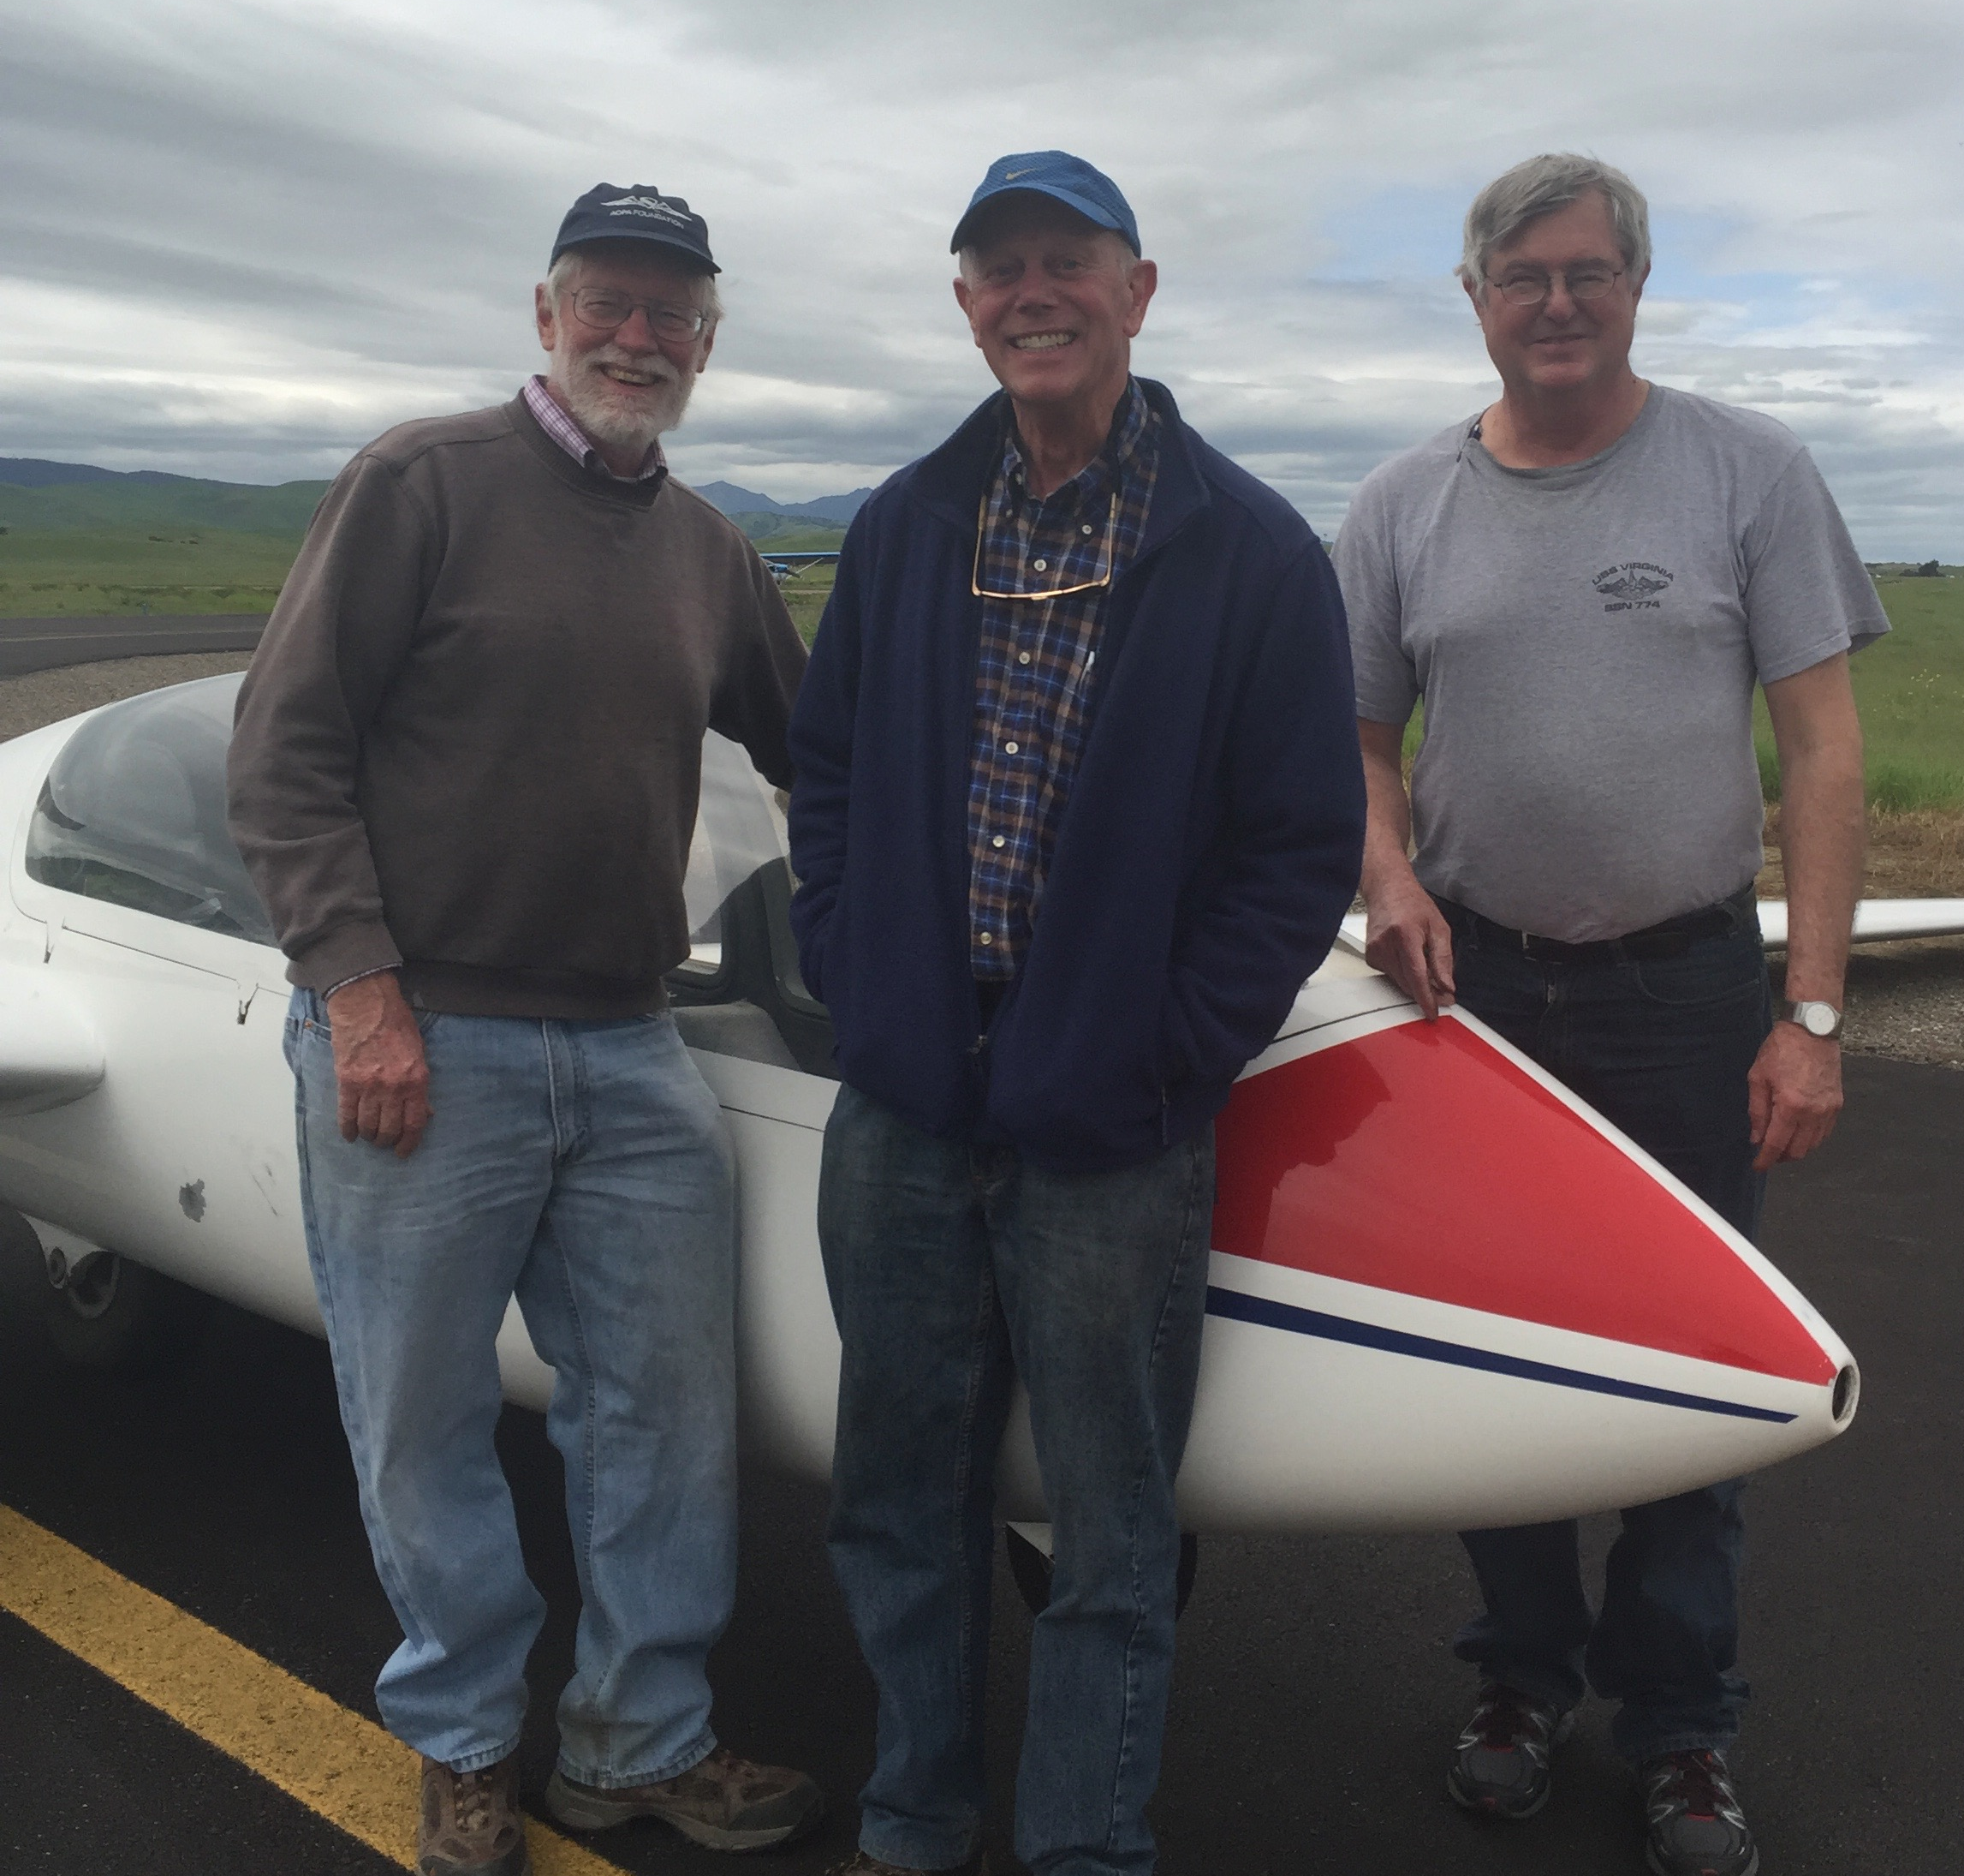
FIRST SOLO in 2017
Brian Fahrqueson-

Slide 5
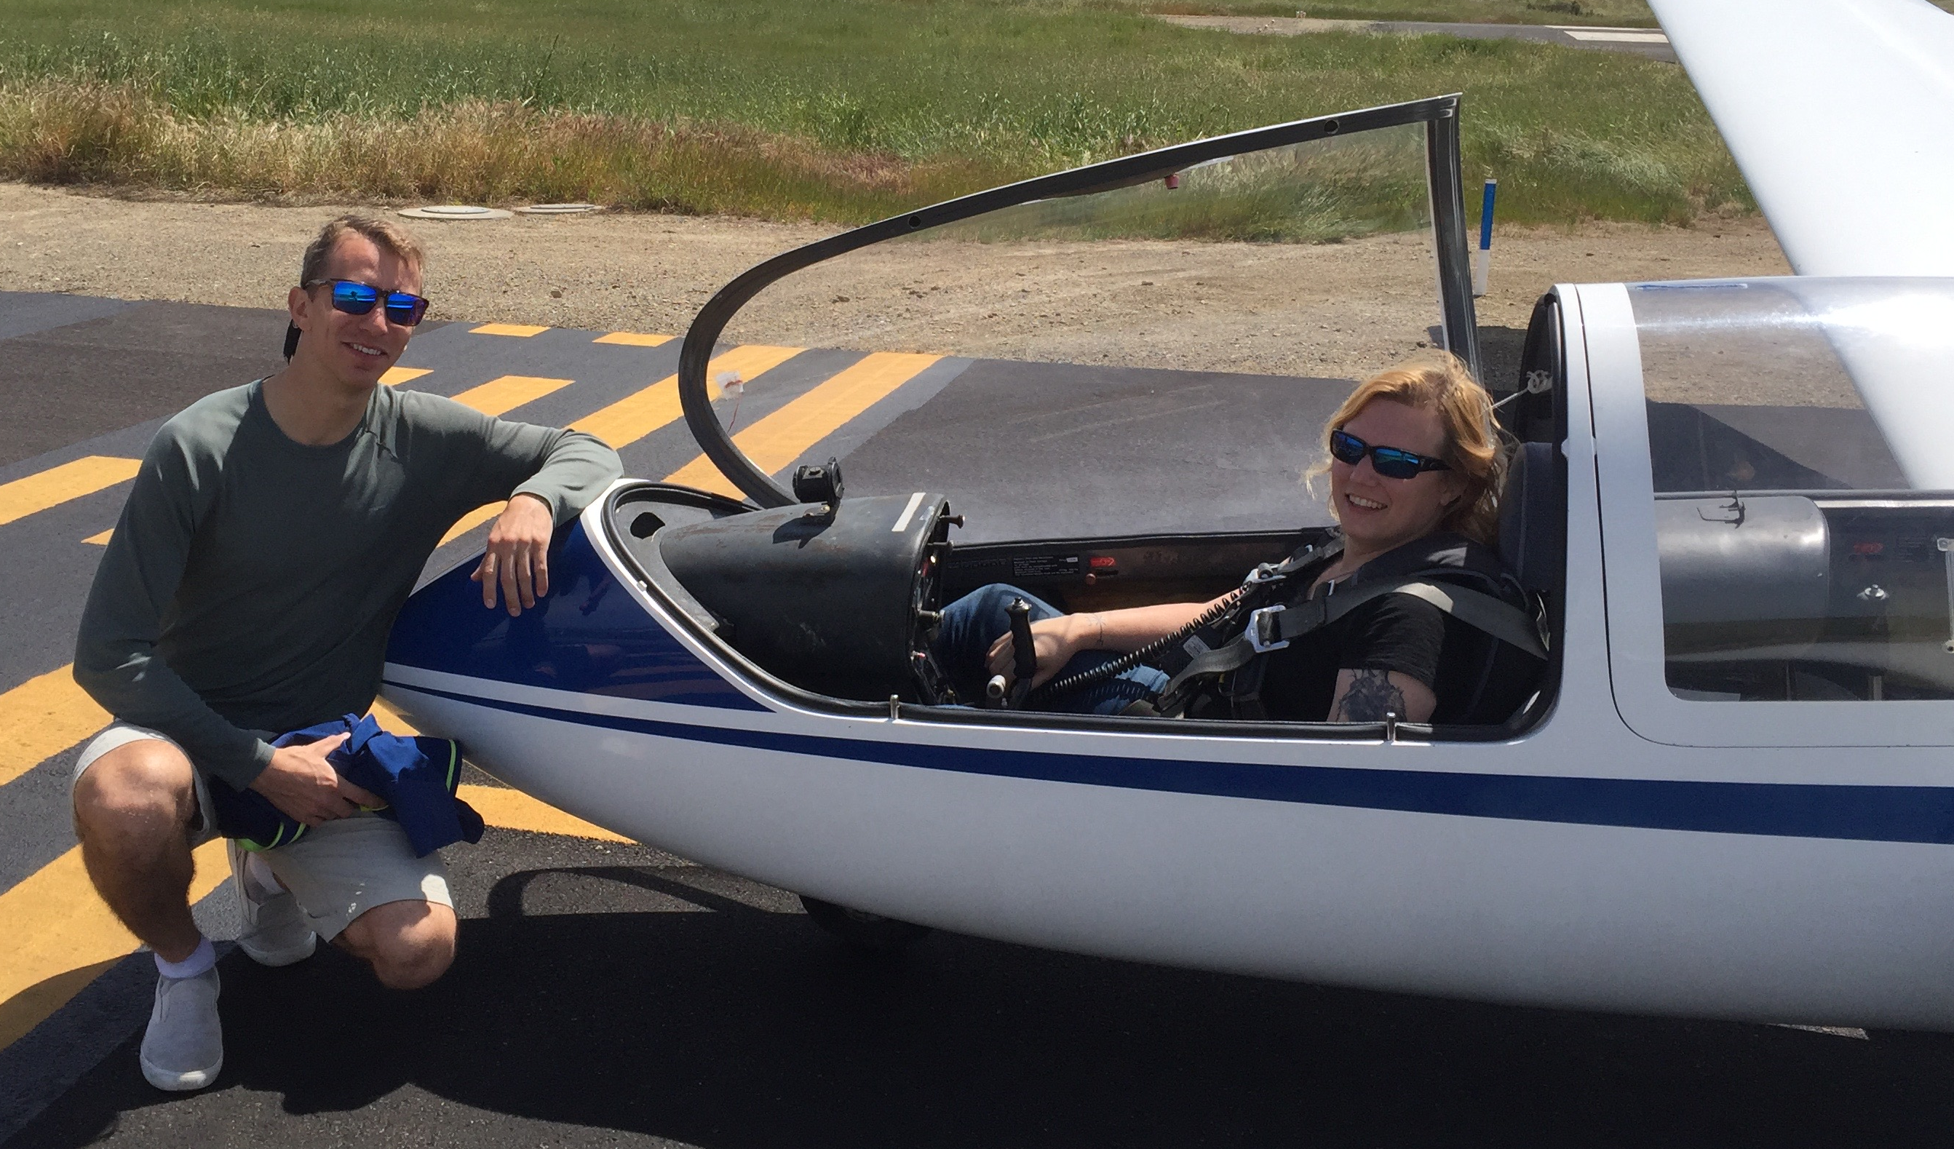
FIRST SOLO in 2017
Dana Davidsen

Slide 6
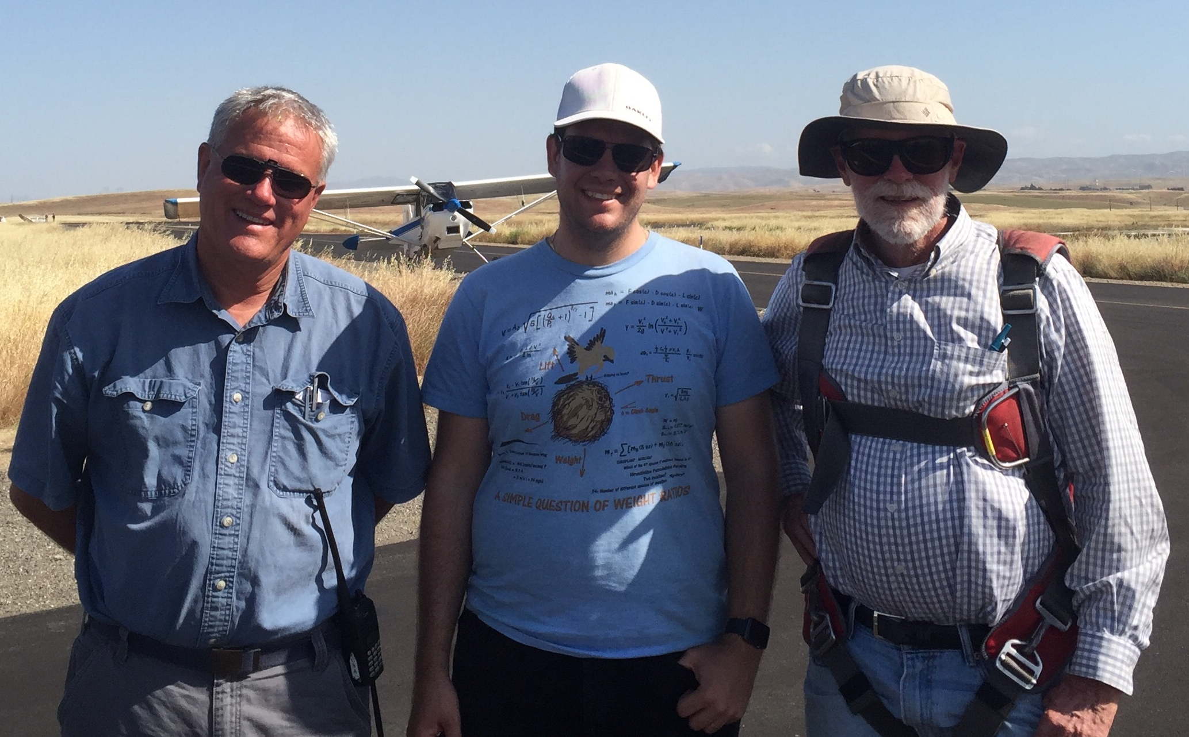
FIRST SOLO in 2017
Peter Rusko

Slide 7
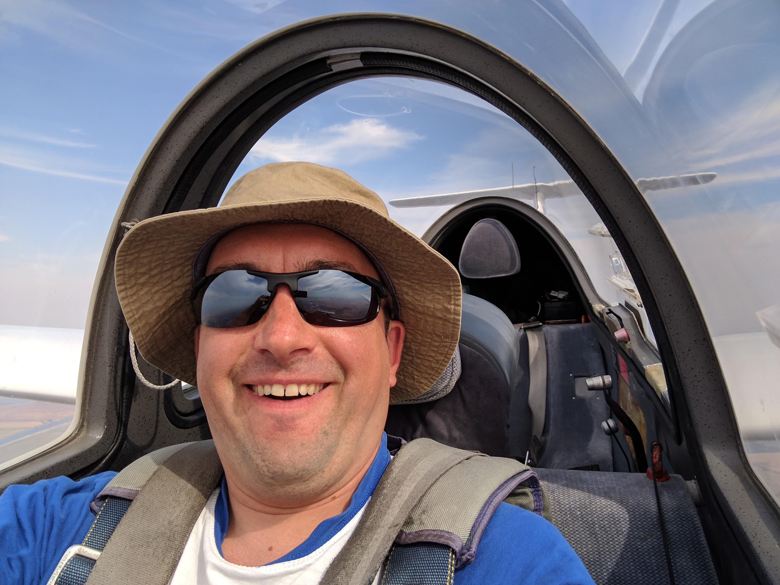
FIRST SOLO in 2017
Sergey Kataev

Slide 8
New Glider Ratings or Wings
Marianne Guerin- Commercial Glider

Slide 9
CHECK-OUTS IN NEW GLIDERS
Brian R- ASW-27B
Sergey- G-103
Marianne- Blanik L-23, L-33
Brent- G-102
Ace- SGS 2-32, L-33, ASW-19
(“The L-33 and the ASW19 both feel amazing to fly. Control is incredible smooth”)

Slide 10
CHECK-OUTS IN NEW GLIDERS
Tom A- ASW-24
Ramy- ASG-29
Larry- ASK-21

Slide 11
Camps
Marianne Guerin- Mentor at XC Camp, WSPA Chilhowie, TN
Buzz Graves- 13th year as mentor at XC Camp
Ace- XC Camp
Van- Bishop Encampment
John S- Assistant Director Thermal Camp & Lead Tow Pilot
Larry- Director Thermal Camp, XC camp mentor, Bishop Encampment

Slide 12
FLIGHTS AT NEW GLIDER SITES
Marianne- Chilhowie, TN for WSPA-2017
Brent- ASI and Truckee
Ace- Panoche- 1st time as PIC
Tom A- Truckee
Van- Bishop
Larry- after years of trailering broken gliders to Williams, finally flew there
Walter- Rosaschi, Tracy

Slide 13
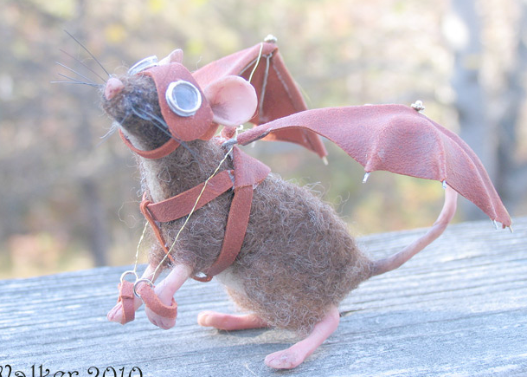
BESTS/MEMORABLE in 2017
Sergey- Truckee flight with Mike Mayo, wave over Diablo with Brent
Marianne- Encounters with the mouse on the way back to Air Sailing from Mt. Lassen.
Brent- Flying solo exploring the Truckee area
Mark V- BFR in May!
Mike M- Being the only one to get around the Tagars course in dubious weather.

Slide 14
BESTS/MEMORABLE in 2017
Larry- Several flights at Truckee in very wet weather wondering where I’d be landing
Tom A- Doing a mountain checkout with Rex in WSC's ASG-32Mi. Still more than 20 miles from the airport, we descended to 4500' and then flew at 90 knots back to the airport with Kempton flying formation alongside. A memorable introduction to flying in high performance gliders.
Ramy- Other than getting run over by the tow plane I had too many memorable moments to list...

Slide 15
BESTS/MEMORABLE in 2017
Ace-
First time playing hooky from work to enjoy a post-frontal day at Byron in February.
First ever flight in wave: North wind wave off Diablo in April.
First time departing glide range of my home airfield in June.
Climbing to 13k' out of TRK with a passenger who decided he was airsick and ready to land just as an un-forecast thunderstorm passed over the airport.

Slide 16
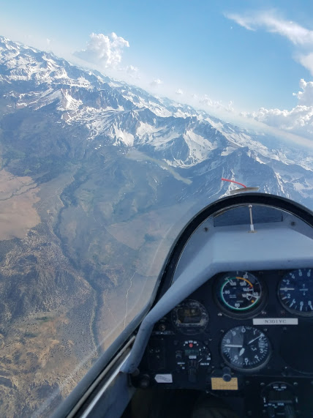

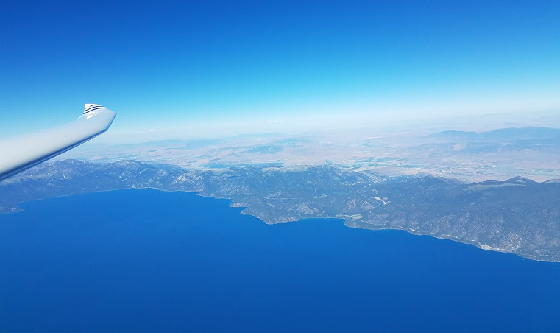
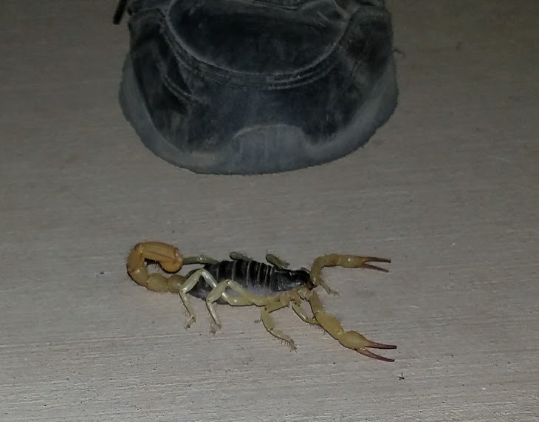
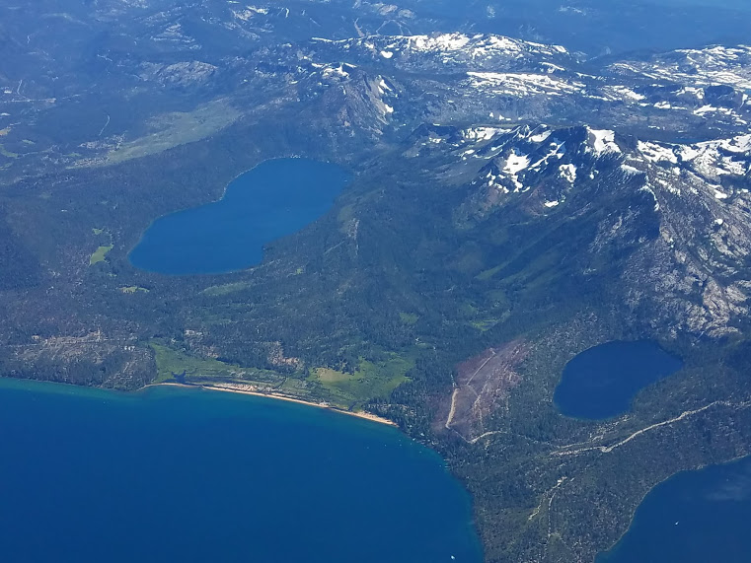
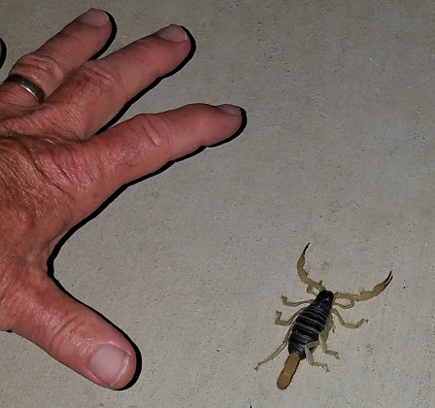
BESTS/MEMORABLE in 2017
Van-The whole Bishop Encampment was a highlight, some very challenging climbs up the Whites and wonderful flights over the Sierras on the west side of The valley.
Flying as Mike Mayo’s “distinguished ballast” in the Region 11 contest out of Truckee.
Meeting new friends at remote soaring sites is always fun!
Landing at Bishop as squall lines passed through, with a 90 degree wind shift, then a 180 degree wind shift, then another 90 degree wind shift, all while covering the last two miles back to the airport...

Slide 17
BESTS/MEMORABLE in 2017
Walter-
1) landed in Tracy on 2/23/17 after crossing the "dangerous" Byron-Tracy gap and didn't make it back. Too optimistic about the conditions. My first flight with a retrieve (easy one I must say since Uber brought me back to Byron for $20 and I could borrow Ramy's car to tow the glider back since I realized I had left my tow hitch at home.)
2) land out at Rosaschi (an abandoned airport) into the weeds which ended in a ground loop with no damage. The aero retrieve was also interesting as it took 3 tries until we succeeded.
3) Sergio was trying to instruct me on some longer distance cross-country days after my Rosaschi landout just to end up getting low close to Rosachi again and landing out at Minden.

Slide 18
More MEMORABLE in 2017
Marianne- 2 Diamond Goal 300 KM flights, but got caught short on paperwork (in different ways) on each. But, they were still memorable, hard fought flights.
Mark V- 1st flight out of Minden
Tom A- Some memorable flights out of Truckee doing Mountain Orientations for our students and new pilots.
Mike M- mentoring a few folks in DuoDiscus 22XC

Slide 19
More MEMORABLE in 2017
Ramy- 5 flights over 1000km from Ely And Tonopah. 3rd place in OLC USA.
Brent- My first season as a licensed pilot
Paul Lowenstein- Resumed flying after 36 (glider) 33 (power) year hiatus.

Slide 20
Goals for 2018
Brian – 500km in my ASW 27!
Buzz- 500km in the club’s 1-26!
Sergey- get rated, checked out in Truckee/ASI and go XC
Marianne- Diamond Goal, ASI Sports Class contest, WSPA 2018 seminar completed!, CFIG
John P- CFIG
Tom A- Have fun flying my recently acquired ASW 20

Slide 21
Goals for 2018
Brent- Fly XC and fly more hours and buy a paddle board for Lake Tahoe
Mark V- More flights
Ace- More cross-country flying (extending beyond the TRK/Nervino/Airsailing triangle area).
Ramy- Fly faster
Mike M- possibly commercial

Slide 22
Goals for 2018
Paul Lowenstein- Solo flying in Sierras. Get a glider.
Larry- Fly more!
Van- Get the Commercial and start on CFIG, Start on the Diamond flights, actually fly while I’m in Moriarty, England, and Canada this year!

Slide 23
Member Achievements and Milestones in 2015
OLC Numbers
Awards and Recognition

Slide 24
TOTAL GLIDER CROSS-2017 OLC COUNTRY KM
Matthew Gast (US) 201
Andrew Chant (CA) 296
Brent Davidson (US) 568
William Snow (US) 907
Jim Alton (US) 922
Marton Kun-Szabo (US) 1080
Thomas Anklam (US) 1080
Ace Lewis (US) 1550
Walter Friedrich (US) 1808

Slide 25
TOTAL GLIDER CROSS-2017 OLC COUNTRY KM
Dan Colton (US) 1945
Van Henson (US) 2159
Brian Roach (US) 2768
Shannon Madsen (US) 3304
Larry Suter (US) 5931
Michael Mayo (US) 6731
Buzz Graves (US) 9871
Ramy Yanetz (US) 33,082

Slide 26
TOTAL NUMBER OF OLC FLIGHTS 2017
Andrew Chant 4
Brent Davidson 6
William Snow 6
Matthew Gast 8
Shannon Madsen 10
John Scott 11
Marton Kun-Szabo 11
Thomas Anklam 11
Walter Friedrich 12

Slide 27
TOTAL NUMBER OF OLC FLIGHTS 2017
Marianne Guerin 14
Van Henson 15
Dan Colton 15
Ace Lewis 18
Brian Roach 20
Michael Mayo 25
Buzz Graves 30
Larry Suter 47
Ramy Yanetz 62

Slide 28
TOTAL OLC GLIDER HOURS- 2017
Matthew Gast 6.4
Andrew Chant 7
John Scott 15.3
Brent Davidson 15.9
William Snow 16.9
Walter Friedrich 20.8
Marton Kun-Szabo 25.4
Thomas Anklam 28.5
Van Henson 30.8

Slide 29
TOTAL OLC GLIDER HOURS- 2017
Dan Colton 32.8
Ace Lewis 41
Shannon Madsen 50
Marianne Guerin 51.2
Brian Roach 52.2
Larry Suter 81
Michael Mayo 81.7
Buzz Graves 136
Ramy Yanetz 355.7

Slide 30
LONGEST FLIGHT (KM) – FROM BYRON 2017 OLC
km kph
9/24/16 Van Henson 32 40
2/23/17 Walter Friedrich 35 58
11/21/16 Brian Roach 60 49
4/29/17 Ace Lewis 106 34
6/10/17 Andrew Chant 115 50
5/13/17 Marton KunSzabo 129 49
4/20/17 Thomas Anklam 131 47
5/13/17 Larry Suter 178 61
2/25/17 Buzz Graves 342 75
5/14/17 Shannon Madsen 358 75
6/11/17 Ramy Yanetz 761 104

Slide 31
LONGEST DISTANCE (KM) – ANYWHERE 2017 OLC
5/18/17 Matthew Gast 17 MEV
6/10/17 Andrew Chant 115 C83
5/13/17 Marton KunSzabo 129 C83
5/28/17 Brent Davidson 137 ASI
7/7/17 Thomas Anklam 140 ASI
9/3/17 Ace Lewis 189 ASI
9/3/17 William Snow 243 TRK
5/4/17 Dan Colton 260 Hollister

Slide 32
LONGEST DISTANCE (KM) – ANYWHERE 2017 OLC
7/30/17 Brian Roach 294 ASI
6/21/17 Van Henson 359 Bishop
6/20/17 Walter Friedrich 378 TRK
5/29/17 Marianne Guerin 381 ASI
7/28/17 Michael Mayo 457 TRK
6/25/17 Larry Suter 554 Bishop
7/22/17 Buzz Graves 643 TRK
6/25/17 Shannon Madsen 659 TRK
7/14/17 Ramy Yanetz 1104 Tonopah

Slide 33
LONGEST DISTANCE (KM) – IN A CLUB SHIP 2017 OLC
km
10/13/16 Van Henson 29 C83 G103
7/11/17 Larry Suter 80 TRK G103
6/30/17 Brian Roach 103 TRK G103
6/10/17 Andrew Chant 115 C83 G103
5/27/17 Dan Colton 118 Pan G103
6/19/17 Walter Friedrich 120 TRK G103
8/10/17 Brent Davidson 125 TRK SS
4/20/17 Thomas Anklam 131 C83 G103
6/14/17 Ace Lewis 165 ASI SS
6/25/17 Marton KunSzabo 205 TRK SS

Slide 34
FASTEST AVERAGE X-C SPEED ANYWHERE (OLC Flight >100km)
kph km
Andrew Chant 51 115
Thomas Anklam 51 128
Ace Lewis 55 165
Brent Davidson 66 136
Marton KunSzabo 75 181
William Snow 86 242
Brian Roach 90 265

Slide 35
FASTEST AVERAGE X-C SPEED ANYWHERE (OLC Flight >100km)
kph km
Marianne Guerin 100 259
Van Henson 105 359
Dan Colton 106 247
Walter Friedrich 106 189
Larry Suter 112 469
Shannon Madsen 116 658
Buzz Graves 126 583
Ramy Yanetz 139 1104
Michael Mayo 140 457

Slide 36
Member Achievements and Milestones in 2015
Numbers
Awards and Recognition

Slide 37
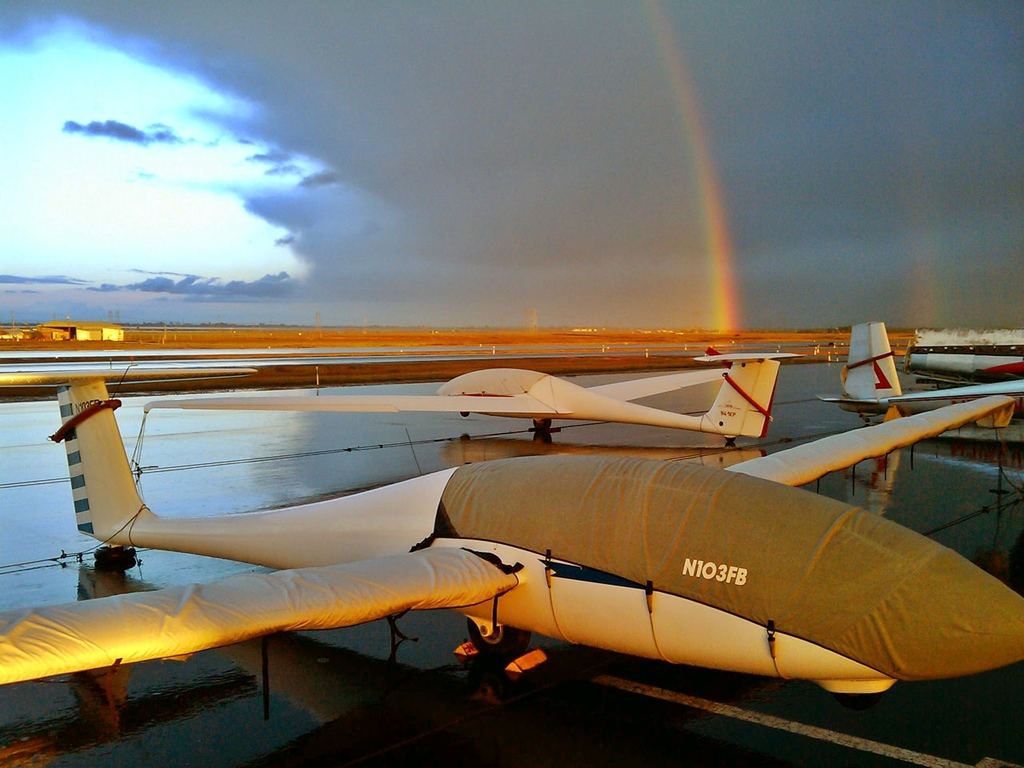
Northern California Soaring Association
Certificate of Achievement 2017
LONGEST DISTANCE FLIGHT
STANDARD CLASS
Marianne Guerin
381 km
Air Sailing, NV May 29, 2017

Slide 38
Northern California Soaring Association
Certificate of Achievement 2017
LONGEST DISTANCE FLIGHT
ADVANCED CLASS
Ramy Yanetz
1104 km
Tonopah, Utah July 14, 2017

Slide 39
Northern California Soaring Association
Certificate of Achievement 2017
FASTEST OLC SPEED FOR A FLIGHT
> 100KM
STANDARD CLASS
Walter Friedrich
106 kph over 189 km
Truckee-Tahoe, CA July 23, 2017

Slide 40
Northern California Soaring Association
Certificate of Achievement 2017
FASTEST OLC SPEED FOR A FLIGHT
> 100KM
ADVANCED CLASS
Michael Mayo
140 kph over 457 km
Truckee, CA July 28, 2017

Slide 41
Northern California Soaring Association
Certificate of Achievement 2017
LONGEST FLIGHT USING A CLUB SHIP
Ace Lewis
165 km
Grob 102 SS
Airsailing, NV June 14, 2017

Slide 42
Northern California Soaring Association
Certificate of Achievement 2017
LONGEST FLIGHT FROM BYRON
Ramy Yanetz
761 km
Byron, CA June 11, 2017

Slide 43
Northern California Soaring Association
Certificate of Achievement 2017
MOST LANDOUTS
Walter Friedrich

Slide 44
NCSA Cross Country Perpetual Trophy
Rules:
Only OLC flights where club is NCSA
Pasco’s Sawyer Award’s rules:
-Can only win twice
-Region 11 flights only
-Score based on OLC “points” X (Pilot Factor)
-The Pilot Factor helps level the field for newer pilots and encourage budding XC pilots
  eg- Ramy, Buzz, Mike S PF=0.7
  Mike Mayo, Larry PF=1.0
  Terence, Marianne, Willie PF=1.5
  Brian, Ace PF=3.0

Slide 45
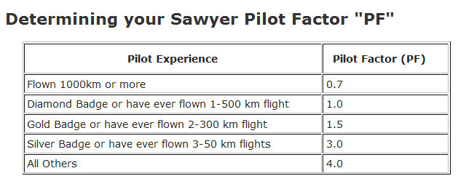
The Pilot Factor gives newer XC pilots a real chance (given that Ramy’s already won it twice)
  eg- Ramy, Buzz, Mike S PF=0.7
  Mike Mayo, Shannon, Larry PF=1.0
  Terence, Marianne, Willy PF=1.5
  Ace, Brian PF=3.0

Slide 46
Order in OLC km flown by NCSA pilots
Ramy Yanetz 33082
Buzz Graves 9871
Michael Mayo 6731
Larry Suter 5932
Shannon Madsen 3304
Marianne Guerin 3233
Brian Roach 2768
Van Henson 2105
Dan Colton 1836
Walter Friedrich 1659
Ace Lewis 1550
Thomas Anklam 1080
Marton Kun-Szabo 1080
William Snow 907
Brent Davidson 568
Andrew Chant 296
Matthew Gast 201

Slide 47
But we only count OLC flights attributed to NCSA
Ramy Yanetz (US) 33082
Buzz Graves (US) 9871
Michael Mayo (US) 6731
Shannon Madsen (US) 3304
Brian Roach (US) 2768
Dan Colton (US) 1763
Ace Lewis (US) 1550
Walter Friedrich (US) 1281
Thomas Anklam (US) 1080
Marton Kun-Szabo (US) 1080
Larry Suter (US) 1039
Jim Alton (US) 922
William Snow (US) 907
Van Henson (US) 612
Brent Davidson (US) 568
Andrew Chant (CA) 296
Matthew Gast (US) 201
Tsk-Tsk

Slide 48
This is the order in “points” only counting flights listed as NCSA
Ramy Yanetz (US) 32781
Buzz Graves (US) 9268
Michael Mayo (US) 6605
Shannon Madsen (US) 3233
Brian Roach (US) 3101
Ace Lewis (US) 1938
Dan Colton (US) 1896
Walter Friedrich (US) 1403
Thomas Anklam (US) 1275
Larry Suter (US) 1228
Marton Kun-Szabo (US) 1133
William Snow (US) 961
Jim Alton (US) 871
Van Henson (US) 635
Andrew Chant (CA) 366
Matthew Gast (US) 297
Brent Davidson (US) 189

Slide 49
The third column shows the all-important Pilot Factor multiplier
Ramy Yanetz (US) 32781 0.7
Buzz Graves (US) 9268 0.7
Michael Mayo (US) 6605 1
Shannon Madsen (US) 3233 1
Brian Roach (US) 3101 3
Ace Lewis (US) 1938 3
Dan Colton (US) 1896 1.5
Walter Friedrich (US) 1403 1
Thomas Anklam (US) 1275 3
Larry Suter (US) 1228 1
Marton Kun-Szabo (US) 1133 3
William Snow (US) 961 1.5
Jim Alton (US) 871 1
Van Henson (US) 635 1.5
Andrew Chant (CA) 366 3
Matthew Gast (US) 297 3
Brent Davidson (US) 189 4

Slide 50
And the winner is:
Brian Roach!
PointsxPF
Ramy Yanetz (US) 22947
Brian Roach (US) 9302
Michael Mayo (US) 6605
Buzz Graves (US) 6487
Ace Lewis (US) 5813
Thomas Anklam (US) 3826
Marton Kun-Szabo (US) 3398
Shannon Madsen (US) 3233
Dan Colton (US) 2843
William Snow (US) 1441
Walter Friedrich (US) 1403
Larry Suter (US) 1228
Andrew Chant (CA) 1099
Van Henson (US) 953
Matthew Gast (US) 892
Jim Alton (US) 871
Brent Davidson (US) 754

Slide 51
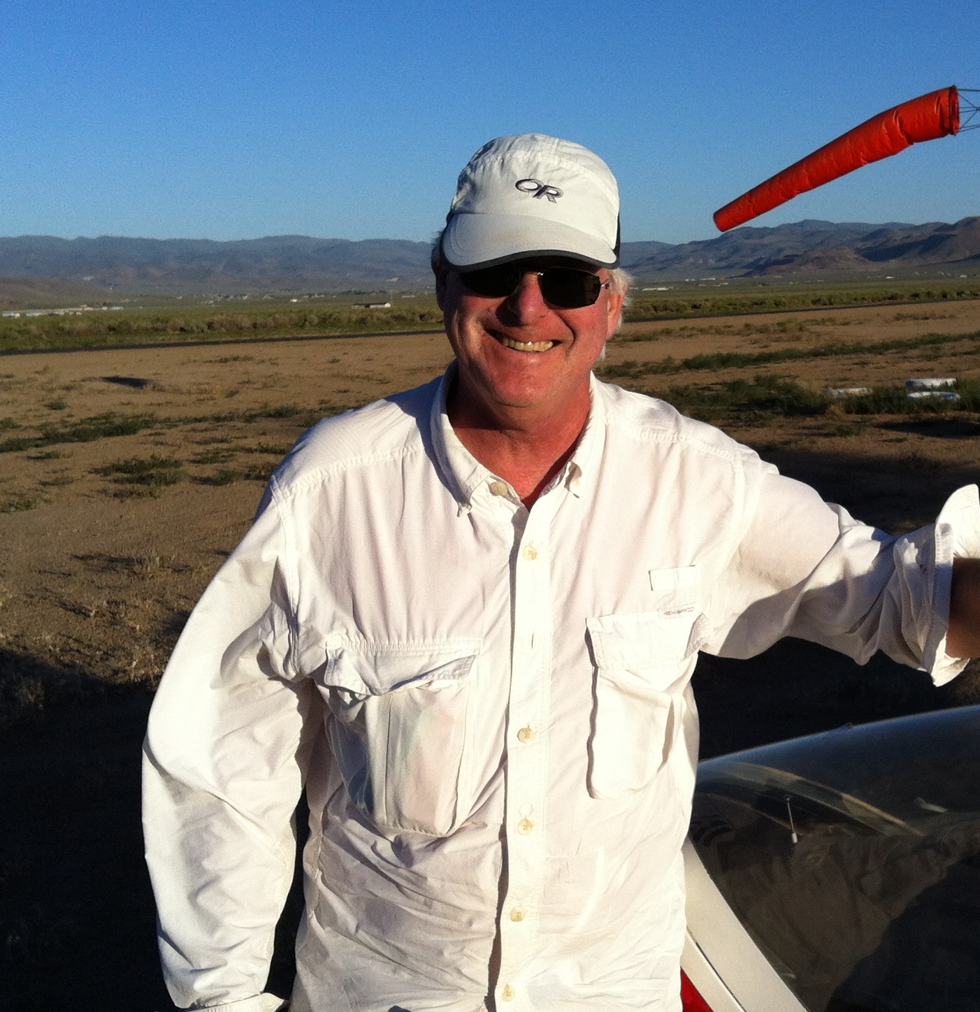
Congratulations Brian!!!!

Slide 52
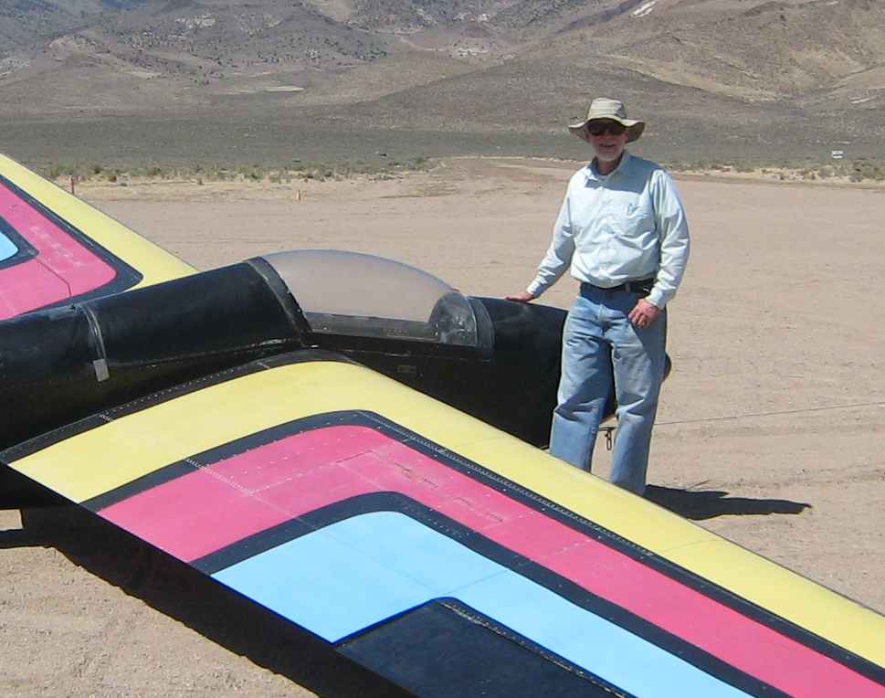
The Coveted 1-26 Trophy recognizing the longest 1-26 OLC flight in 2017
Larry Suter
63 km
Air Sailing Thermal Camp
6/7/17

Slide 53
MOST IMPROVED PILOT 2017:
Won the NCSA XC perpetual trophy in spite of spending endless hours doing maintenance on club gliders and 1YC
Skillfully managed his task distances to be just under 300km, thus preserving his x3 pilot factor
And did it all w/o the winglets we now know he’s been dreaming of

Slide 54
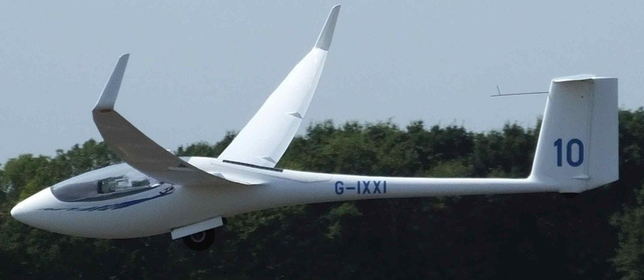
Brian Roach

Slide 55
Northern California Soaring Association
Certificate of Achievement 2017
MOST IMPROVED PILOT
Brian Roach

Slide 56
2017 Tow Pilots
Paul MacDonald Chief Tow Pilot
Dave Magaw
Shamim Mohamed
Ed Ott
Rick Robbins
Dale Roberts
John Scott
Dean Hickman Smith

Slide 57
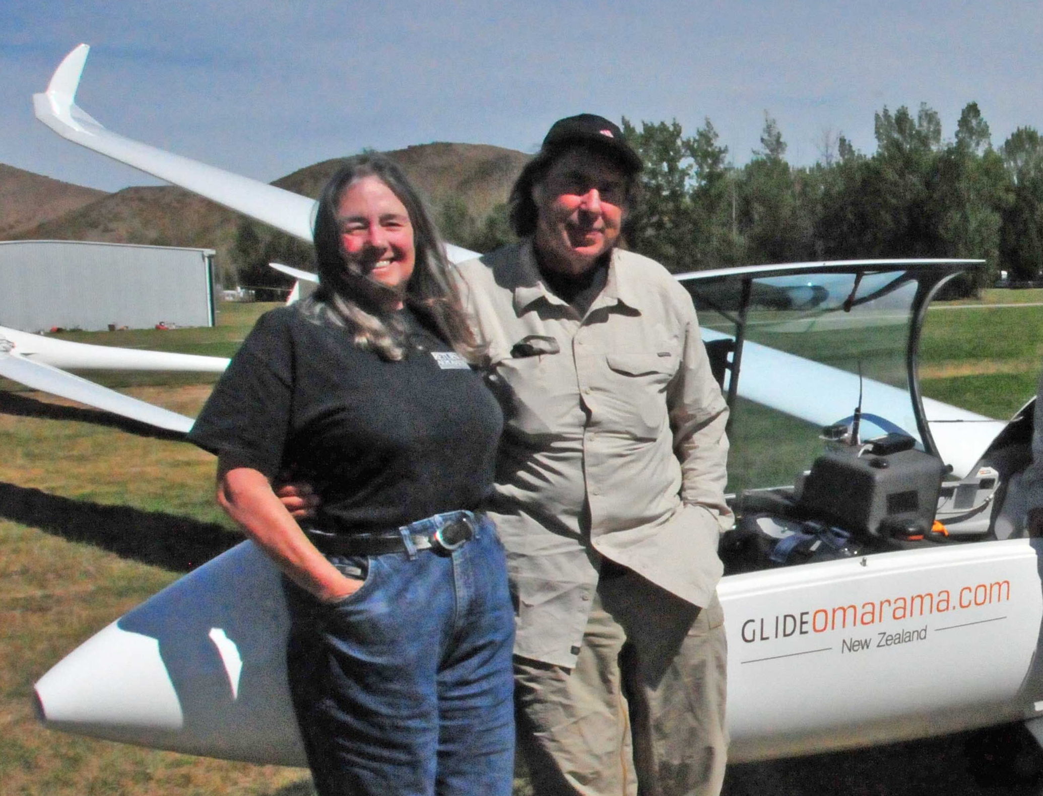
2017 Tow Pilot of the Year:
Dale Roberts

Slide 58
Northern California Soaring Association
Certificate of Achievement 2017
TOW PILOT OF THE YEAR
DALE ROBERTS

Slide 59
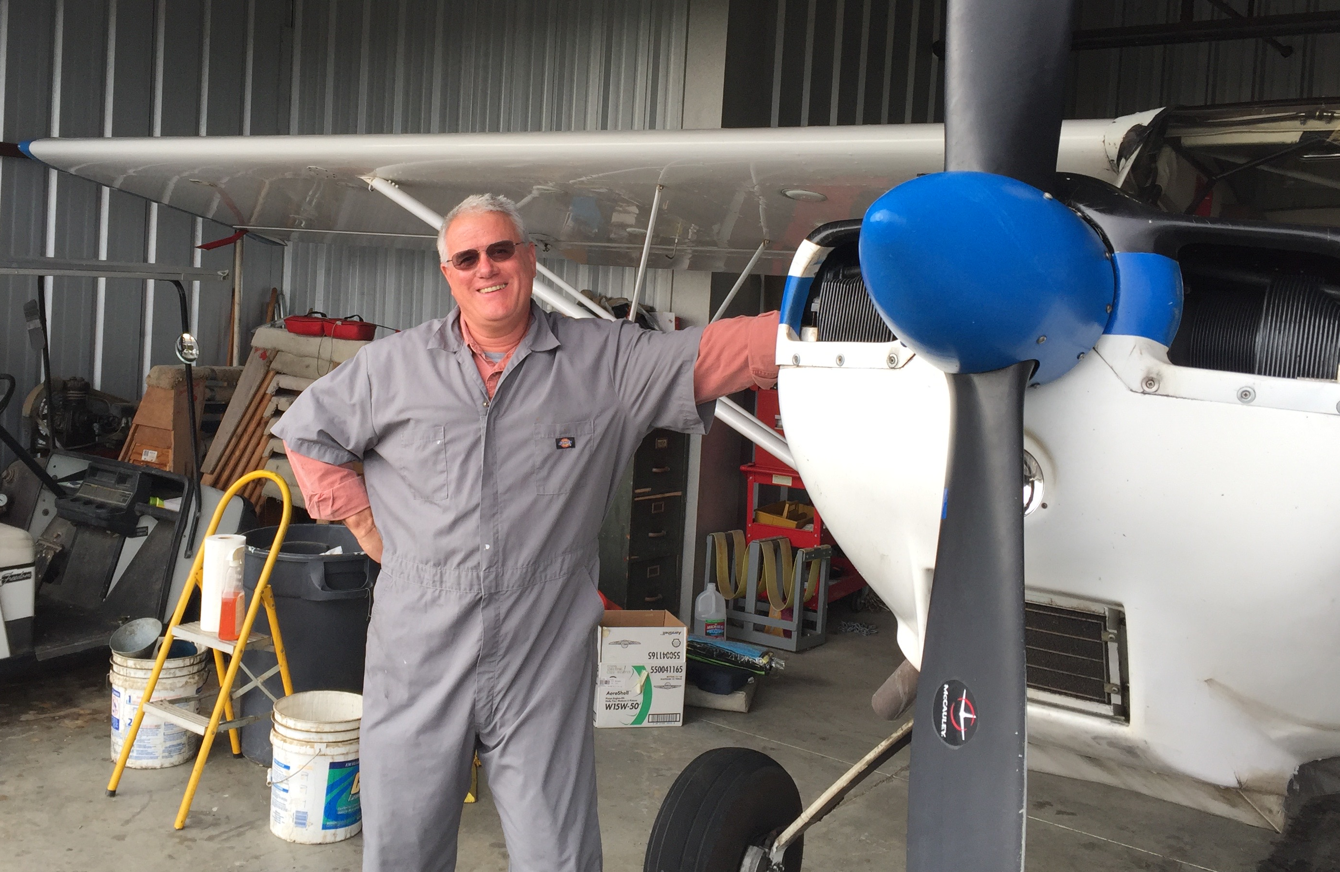
2017 Spark Plug:
John Scott

Slide 60
Northern California Soaring Association
Certificate of Achievement 2017
NCSA SPARK PLUG AWARD
JOHN SCOTT

Slide 61
2017 Flight Instructors
John Boyce
Matthew Gast
Buzz Graves
John Randazzo
Mike Schneider
Larry Suter
Terence Wilson

Slide 62
Northern California Soaring Association
Certificate of Achievement 2017
INSTRUCTOR OF THE YEAR
BUZZ GRAVES

Slide 63
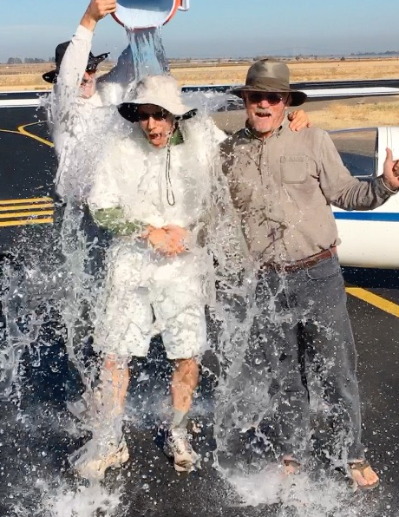
2017 Instructor Of The Year:
Buzz Graves
Typical Student
Buzz

Slide 64
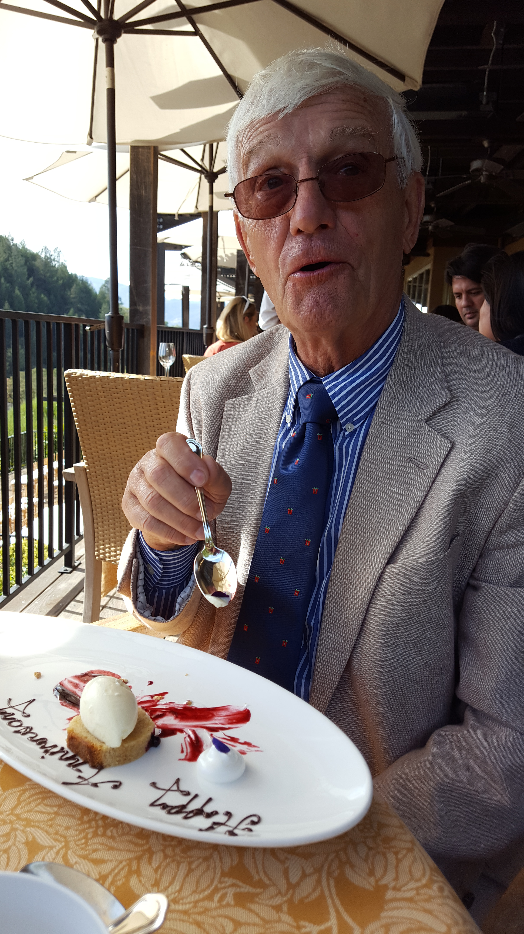
2017 Presidential Award:
John Jewell

Slide 65
Northern California Soaring Association
Certificate of Achievement 2017
SPECIAL PRESIDENTIAL AWARD
FOR MERITORIOUS SERVICE
JOHN JEWELL

