Slide 1
N.C.S.A BUSINESS MEETING/
AWARDS DINNER - 2020

Slide 2
Member Achievements and Milestones in 2019
Numbers
Awards and Recognition

Slide 3
Solos or re-solos
Montek Sethi- first solo

Slide 4
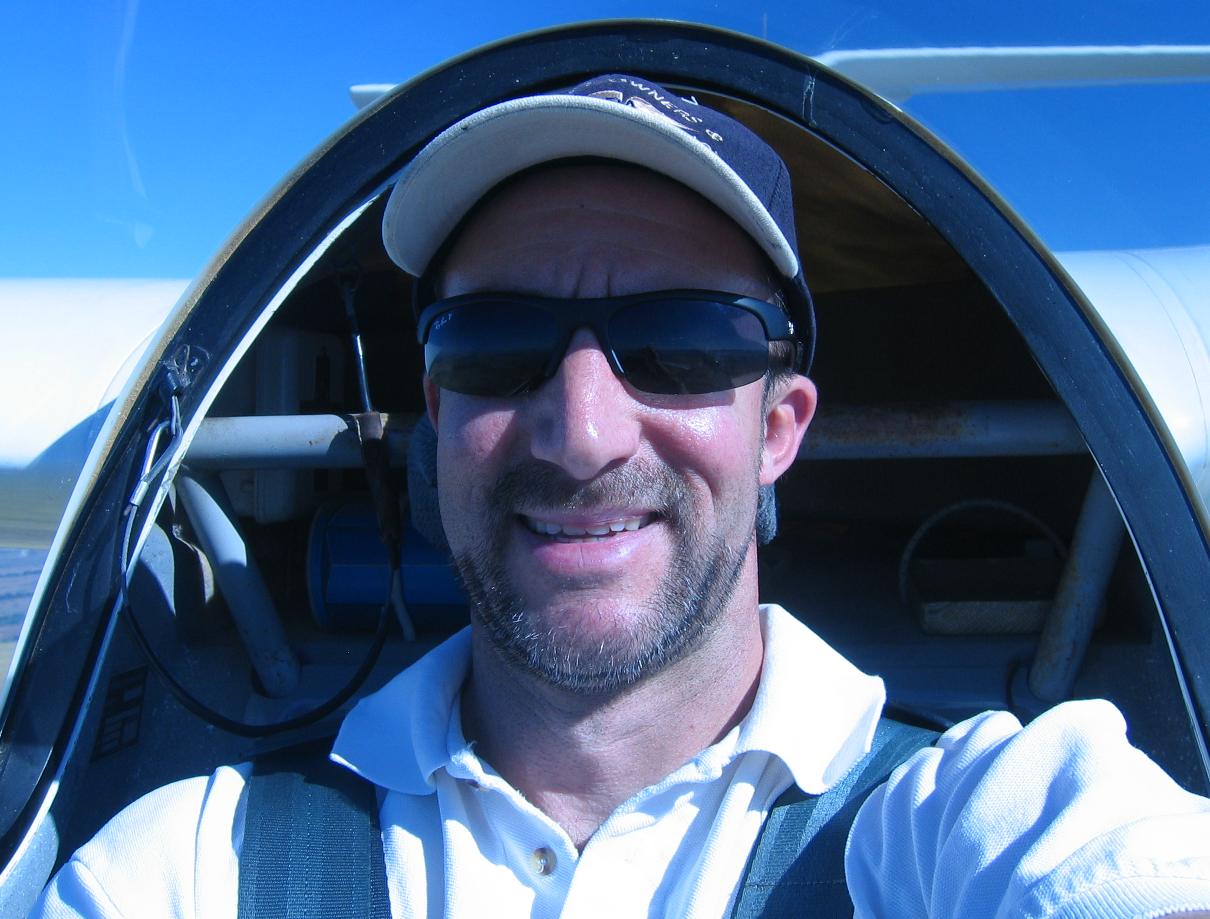
Solos or re-solos
Craig Payne- Resolo

Slide 5
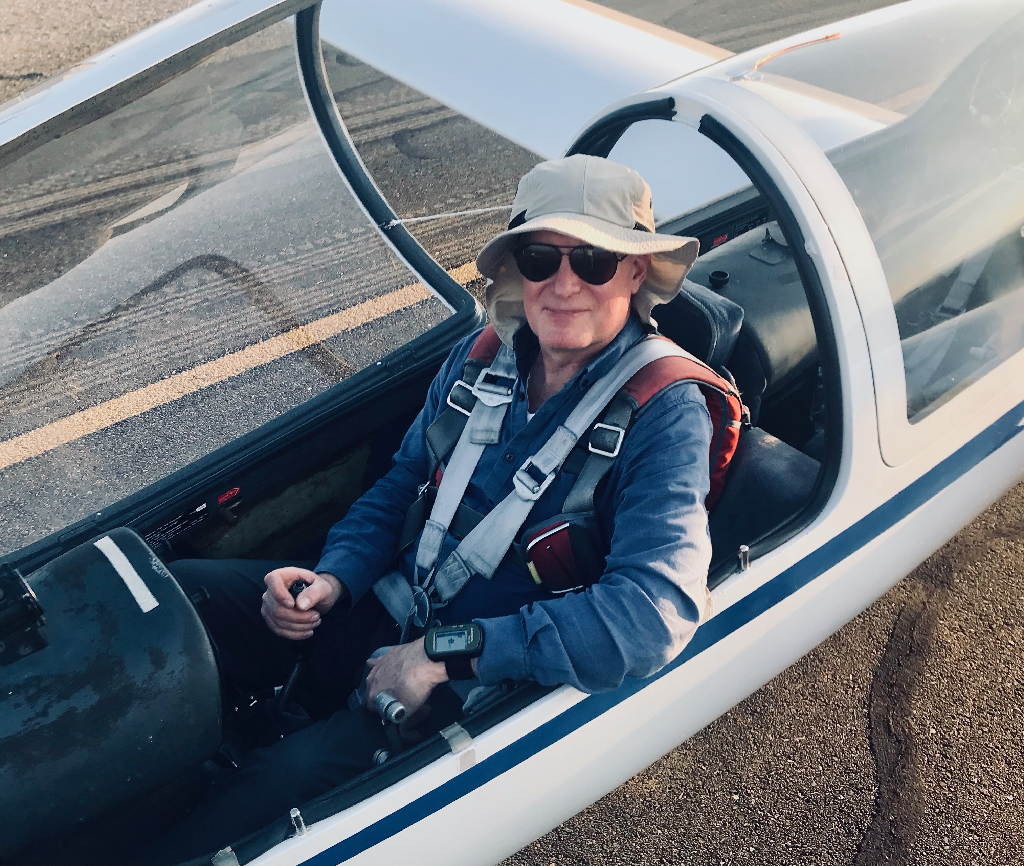
Solos or re-solos
Michael Demeyer- Resolo after ~38 years

Slide 6
Solos or re-solos
Charlie Bellenie- First Glider Solo

Slide 7
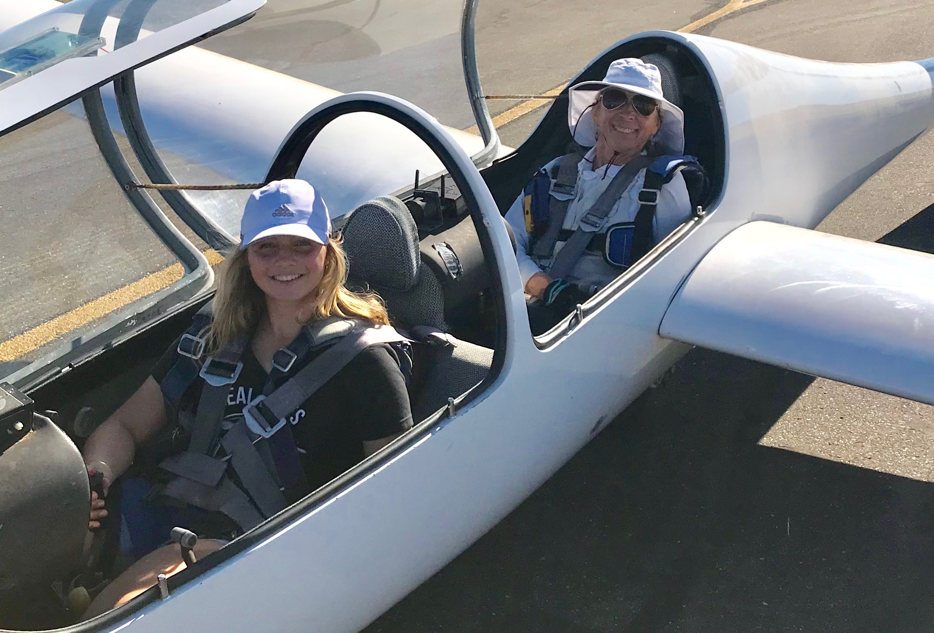
New Glider Ratings or Wings
Marianne Guerin- CFI-G!!!!

Slide 8
New Glider Ratings or Wings
Val Mayamsin- Added Sport ASEL to his glider rating
Morteza- Completed a Wings Basic Level Phase for his 61.56 Flight Review

Slide 9
CHECK-OUTS IN NEW GLIDERS
Montek Sethi- Grob 103
Craig Payne- Grob 103
Michael Demeyer- Grob 103

Slide 10
2019 Camps
Sergey Kataev- XC Camp
Peter Rusko- XC Camp
Dan Colton- ASA Camp at Parowan
Ramy - Parowan, Tonopah, Ely, Panoche
John S- Assistant Director Thermal Camp & Lead Tow Pilot
Larry- Director Thermal Camp, XC camp mentor, Instructor at Truckee Youth Soaring Camp

Slide 11
2019 Camps
Mike M- Contest Director at FAI Region 11 contest at Truckee

Slide 12
FLIGHTS AT NEW GLIDER SITES
Dan C- Parowan, UT
Paul Lowenstein- Truckee
Marianne- Omarama, NZ
Paul MacDonald- Omarama, NZ

Slide 13
FLIGHTS AT NEW GLIDER SITES
Craig P- Byron
Michael D- Byron
Montek - Byron
Sunny – Byron
Claus Weissman- Byron
  Our newest flight instructor

Slide 14
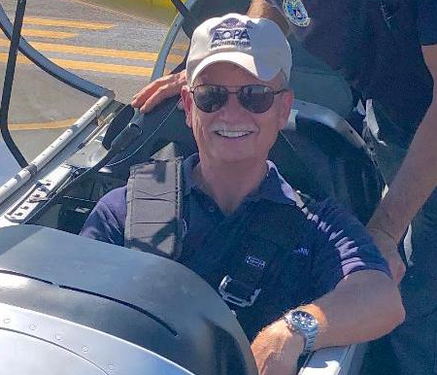
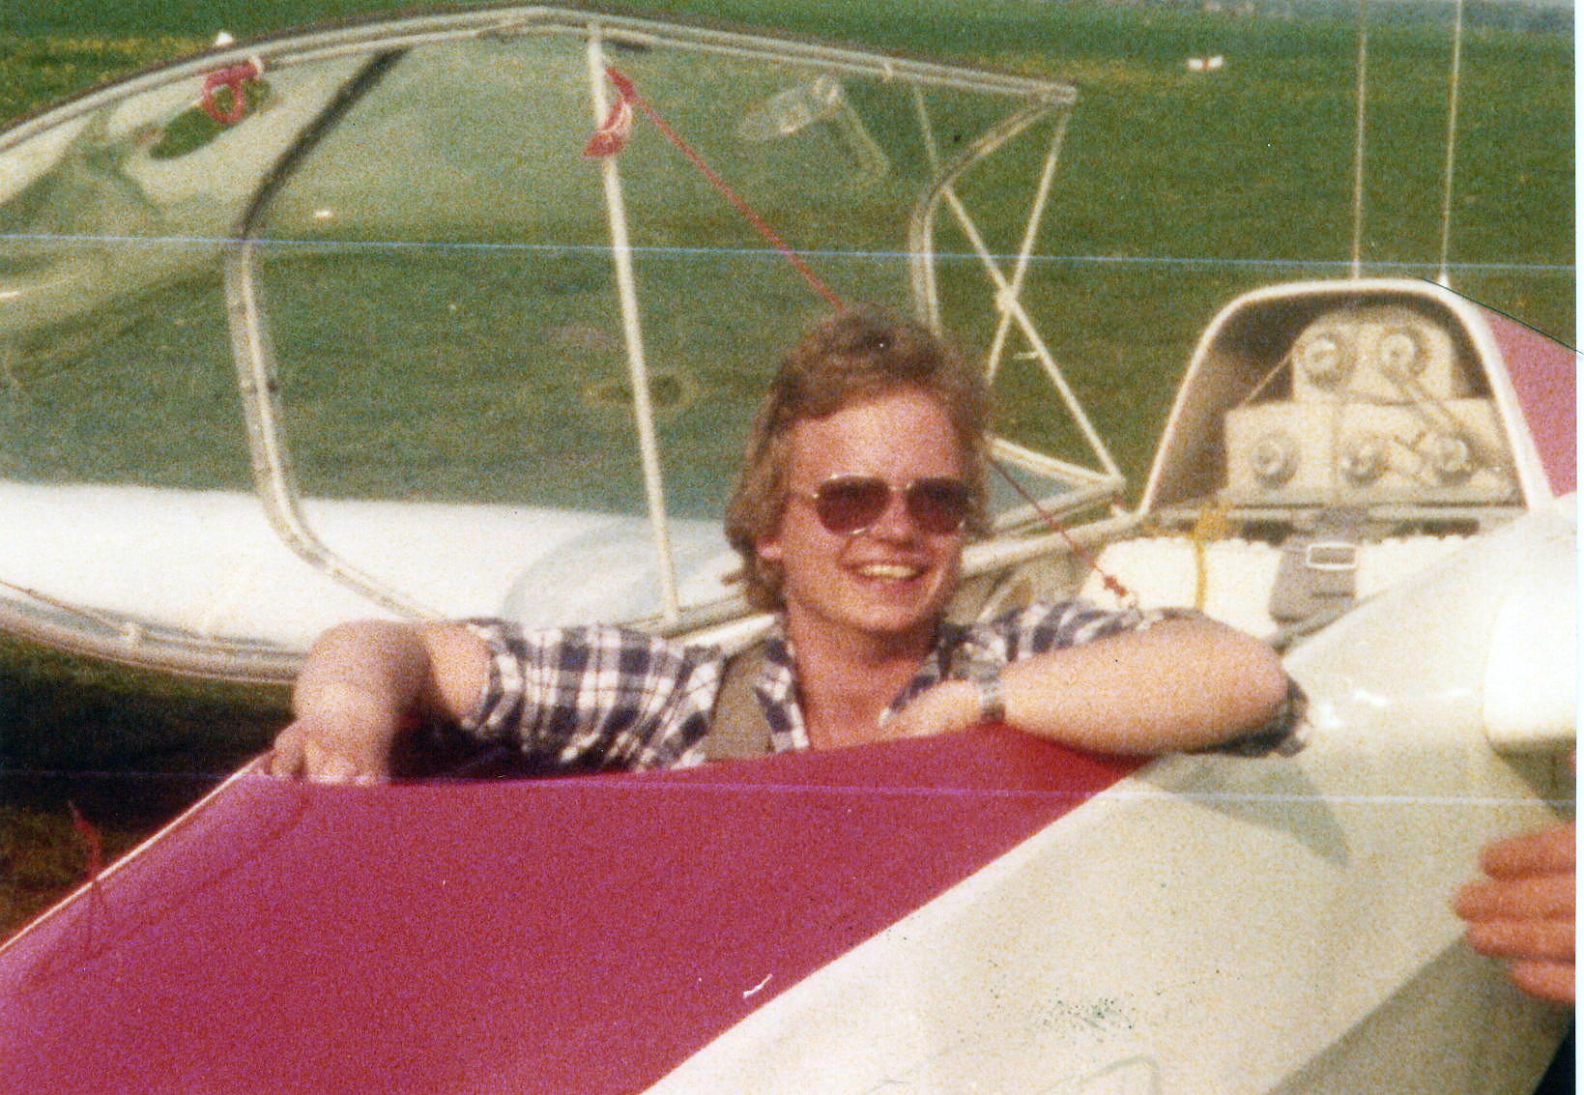
Introducing Claus Weissman
Soloed in Germany when he was 14 (a while ago)
Still smiling years later in a CAP L-23

Slide 15
Claus is a:
ATP
CFI
CFI-G
Instructed at Long Island Soaring
Moved to the Bay Area last year
March 1st will be his first day as duty instructor

Slide 16
Landouts in 2019
Val- two off-field landings, one airport landout.
Tom Anklam- 5 land outs this year. Tracy, Sierraville, 2 in Carson City and one in a field alongside Bear Valley Ranch Road - that was the "interesting" one. Told Bruce Roberts I'd buy him a nice dinner for coming to get me. But by the time we got back to Williams, the only option was Carl's Junior as they mopped the floor around us.
Paul L- Carson City (classic failed return to Truckee). Hollister (diversion due to wind).
Brent Davidson- SS in Sierraville, twice.

Slide 17
Landouts in 2019
Ramy- More than ever! Time for a motor glider? Tracy (twice), Harris Ranch, Ramona’s ranch (required tractor retrieve from the plowed field), Panoche (planned), Heber City (planned), Panguitch UT, Battle Mountain (planned), Modesto, Reid Hillview, New Jerusalem (Uber retrieve)

Slide 18
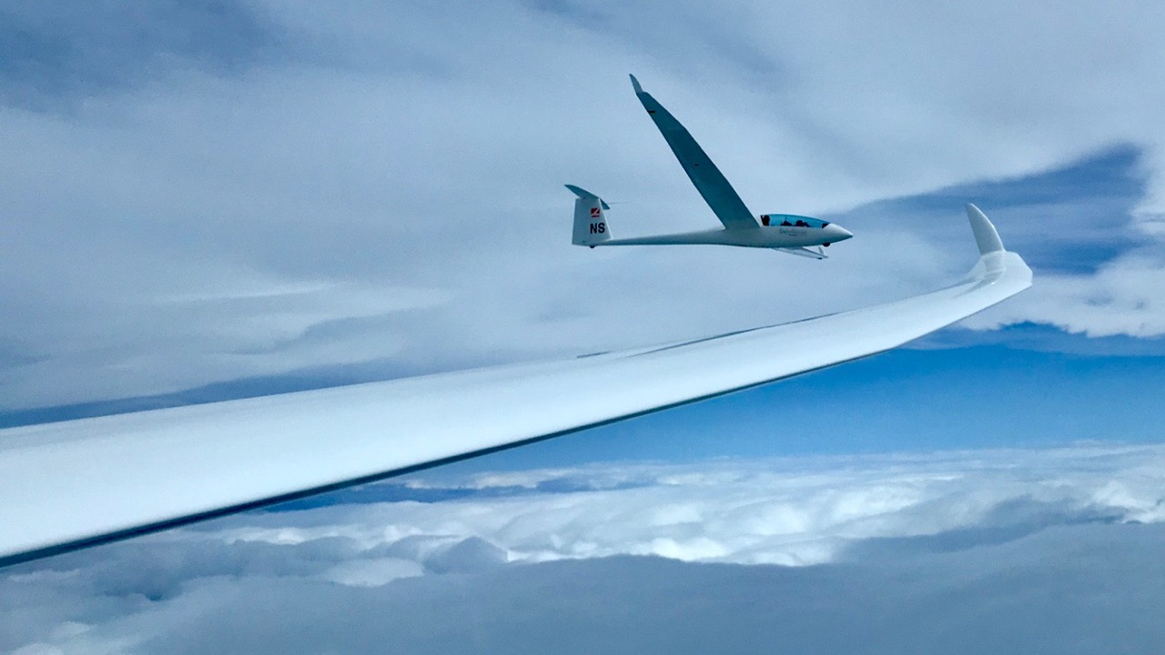
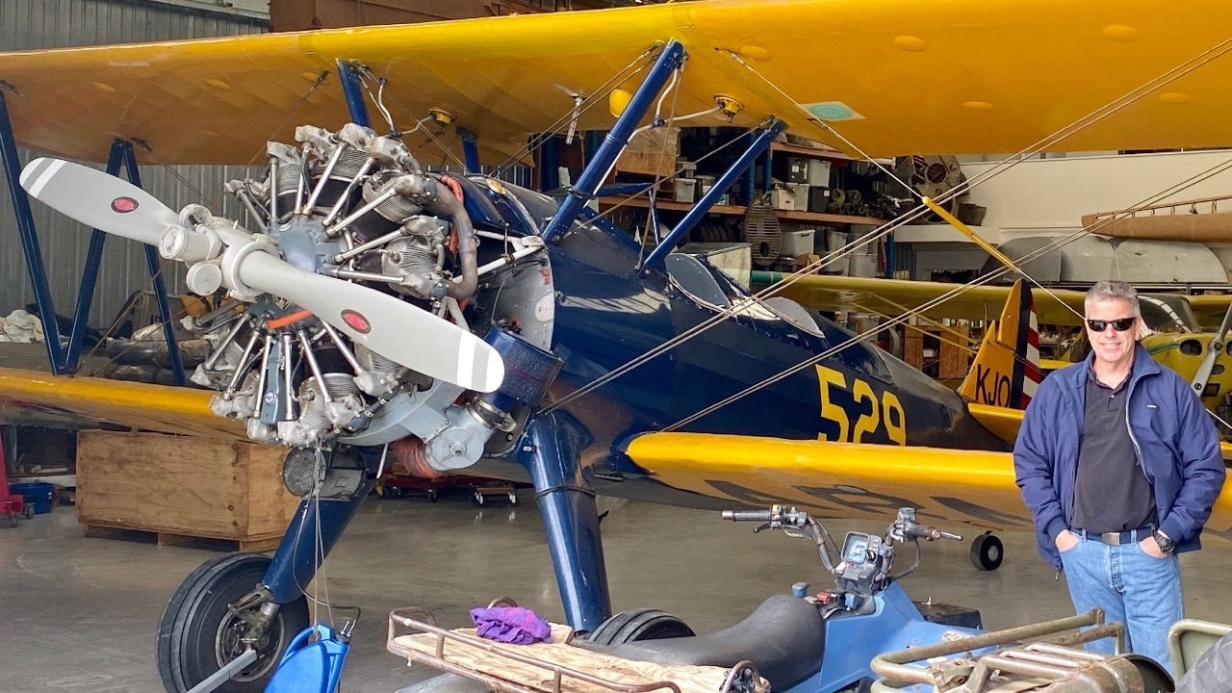
BESTS/MEMORABLE in 2019
Paul McDonald-In September: soaring the Southern Alps out of Omarama, New Zealand. with my wife, flying two Duo Discus sailplanes to over 22,000 feet. My Instructor Pilot was Gavin Wills. Charissa's was Milan Kmetovics. (While in New Zealand, I was also reunited with a 450 Stearman that I towed banners/billboards with out of Oakland for ten years.)

Slide 19
BESTS/MEMORABLE in 2019
John Boyce- Sending Charlie Bellenie solo – Yay Charlie!
. Cool Diablo wave flight with Alex Neigher
Tom Anklam- Did a 350 km out of Truckee south to Bridgeport/Mono Lake Area, mostly over the Eastern Sierras, with long stretches between 16K and 18K. Was not in Kansas Anymore on that one.
Close encounter with two F-16s at 16K while flying along the East Rim of Lake Tahoe. Dipped their wings to get a better look at me as they roared by. Awe inspiring but...

Slide 20
BESTS/MEMORABLE in 2019
Mike Mayo- Doing CD for the Region 11 contest at Truckee
Montek- 1st Solo1
My first thermalling solo flight was 55 minutes, until I was told to come down due to the next student's turn.
Paul L- Wave to nearly 18k twice from Byron. First ever glider diversion (too windy at Byron to land on 27 October).
Roy Moeller- Finally got the Cirrus back in the air at Truckee after a long hiatus.

Slide 21
BESTS/MEMORABLE in 2019
Dan C- 200km spring xc soaring flights from Byron. Why doesn't everyone do them?
302km xc flight from Williams. Personal longest from Williams.
First soaring safari (with Ramy Yanetz TG and Eric Rupp ER). 343km summer xc soaring flight from Parowan, Utah. Cloud bases at 17k with long streets. Little less sightseeing and picture taking and could have easily done 750km.
445km xc soaring flight from Truckee. PERSONAL BEST Distance from anywhere.

Slide 22
BESTS/MEMORABLE in 2019
Marianne- Soaring Wave in Omarama, NZ
Finished CFI-G rating
Michael Demeyer- Flying again after 40 years
Val- First crosscountry flights, first 360km, a few other long flights
2 off-field landouts

Slide 23
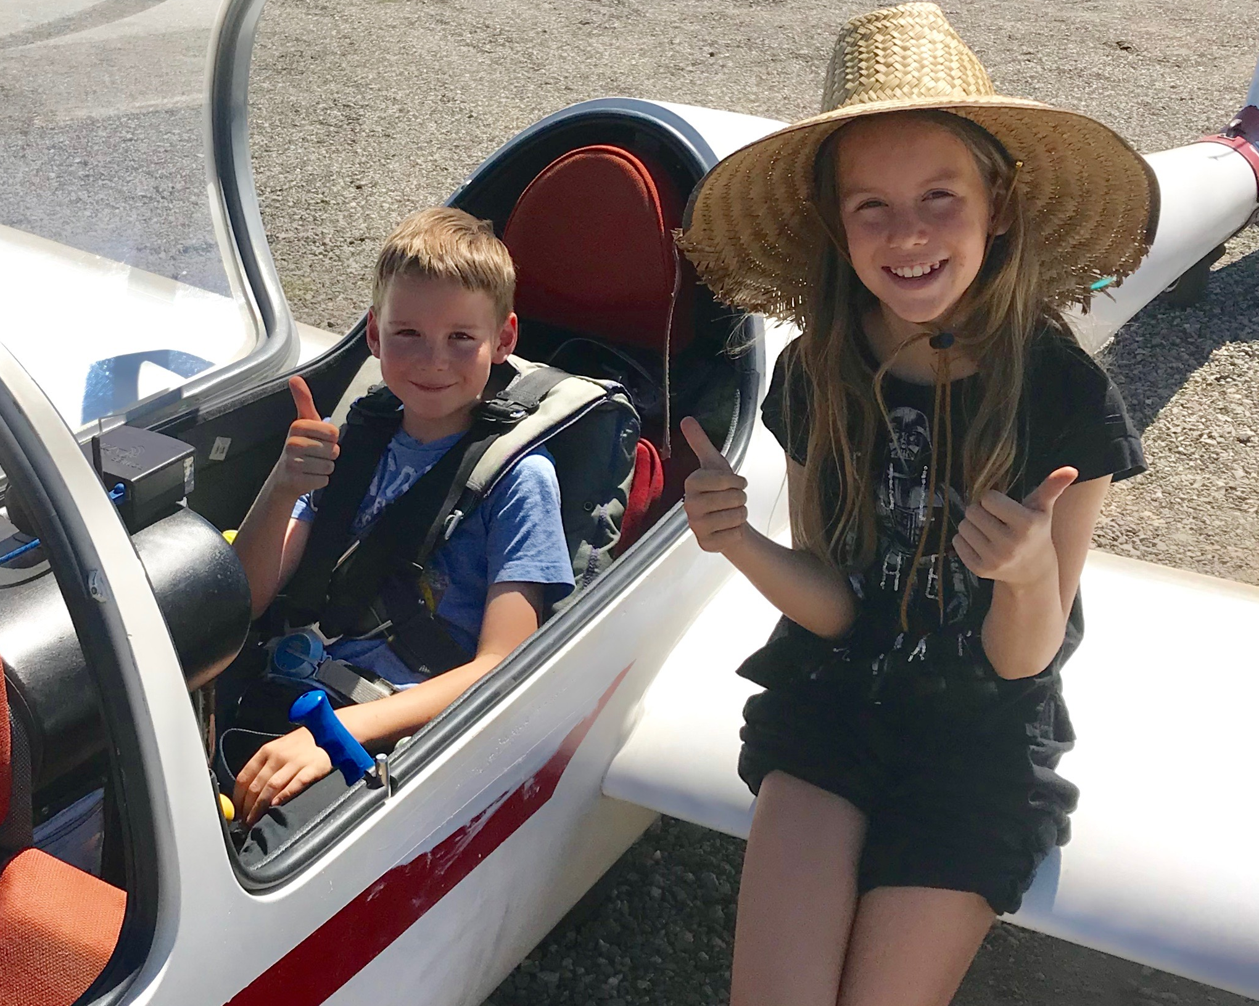
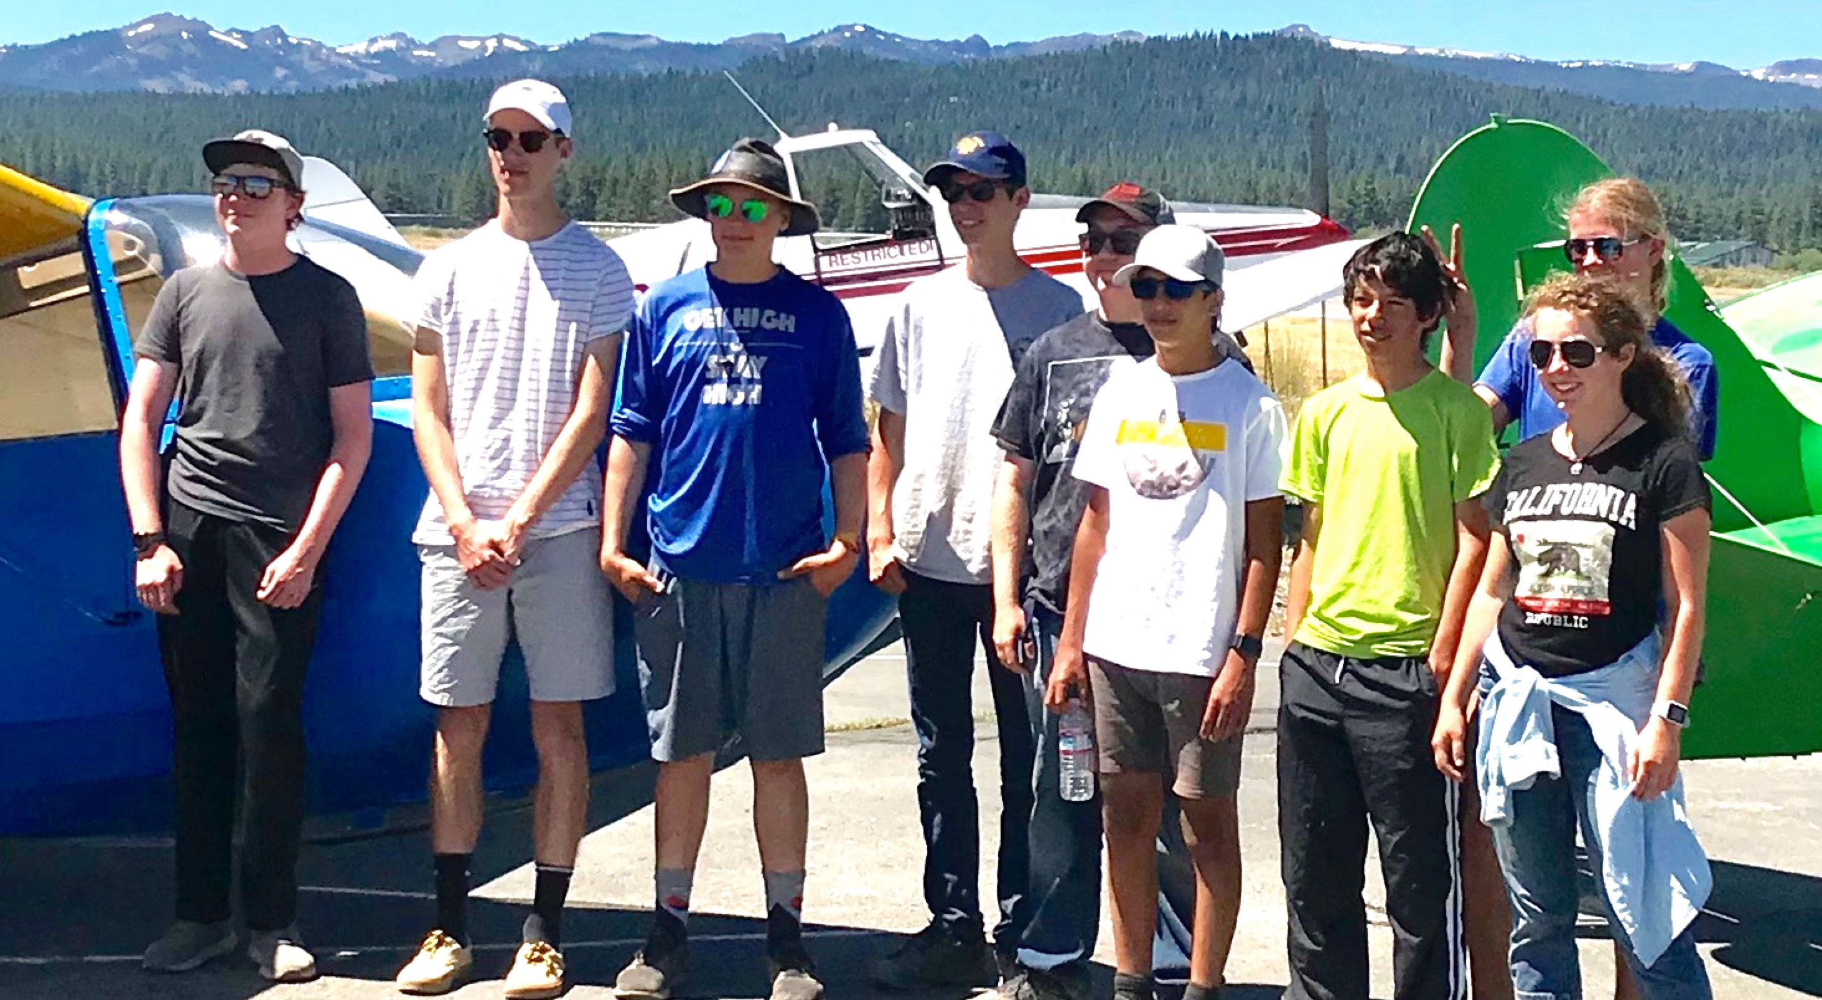
BESTS/MEMORABLE in 2019
Larry- Instructing at Truckee Youth Soaring Camp
Taking two of our grandkids for 1hr+ flights at Truckee

Slide 24
BESTS/MEMORABLE in 2019
Ramy- Flying for the first time with my 19 years old son in 81C. We flew nearly 130 km XC over San Antonio Valley in 3 hours getting to 9500 feet
9 flights over 1000km (8 consecutive) The most I ever done in one season. 2nd place US OLC champion. 1st place Tehachapi Dust Devil Dash.
Mike M- First time doing contest director

Slide 25
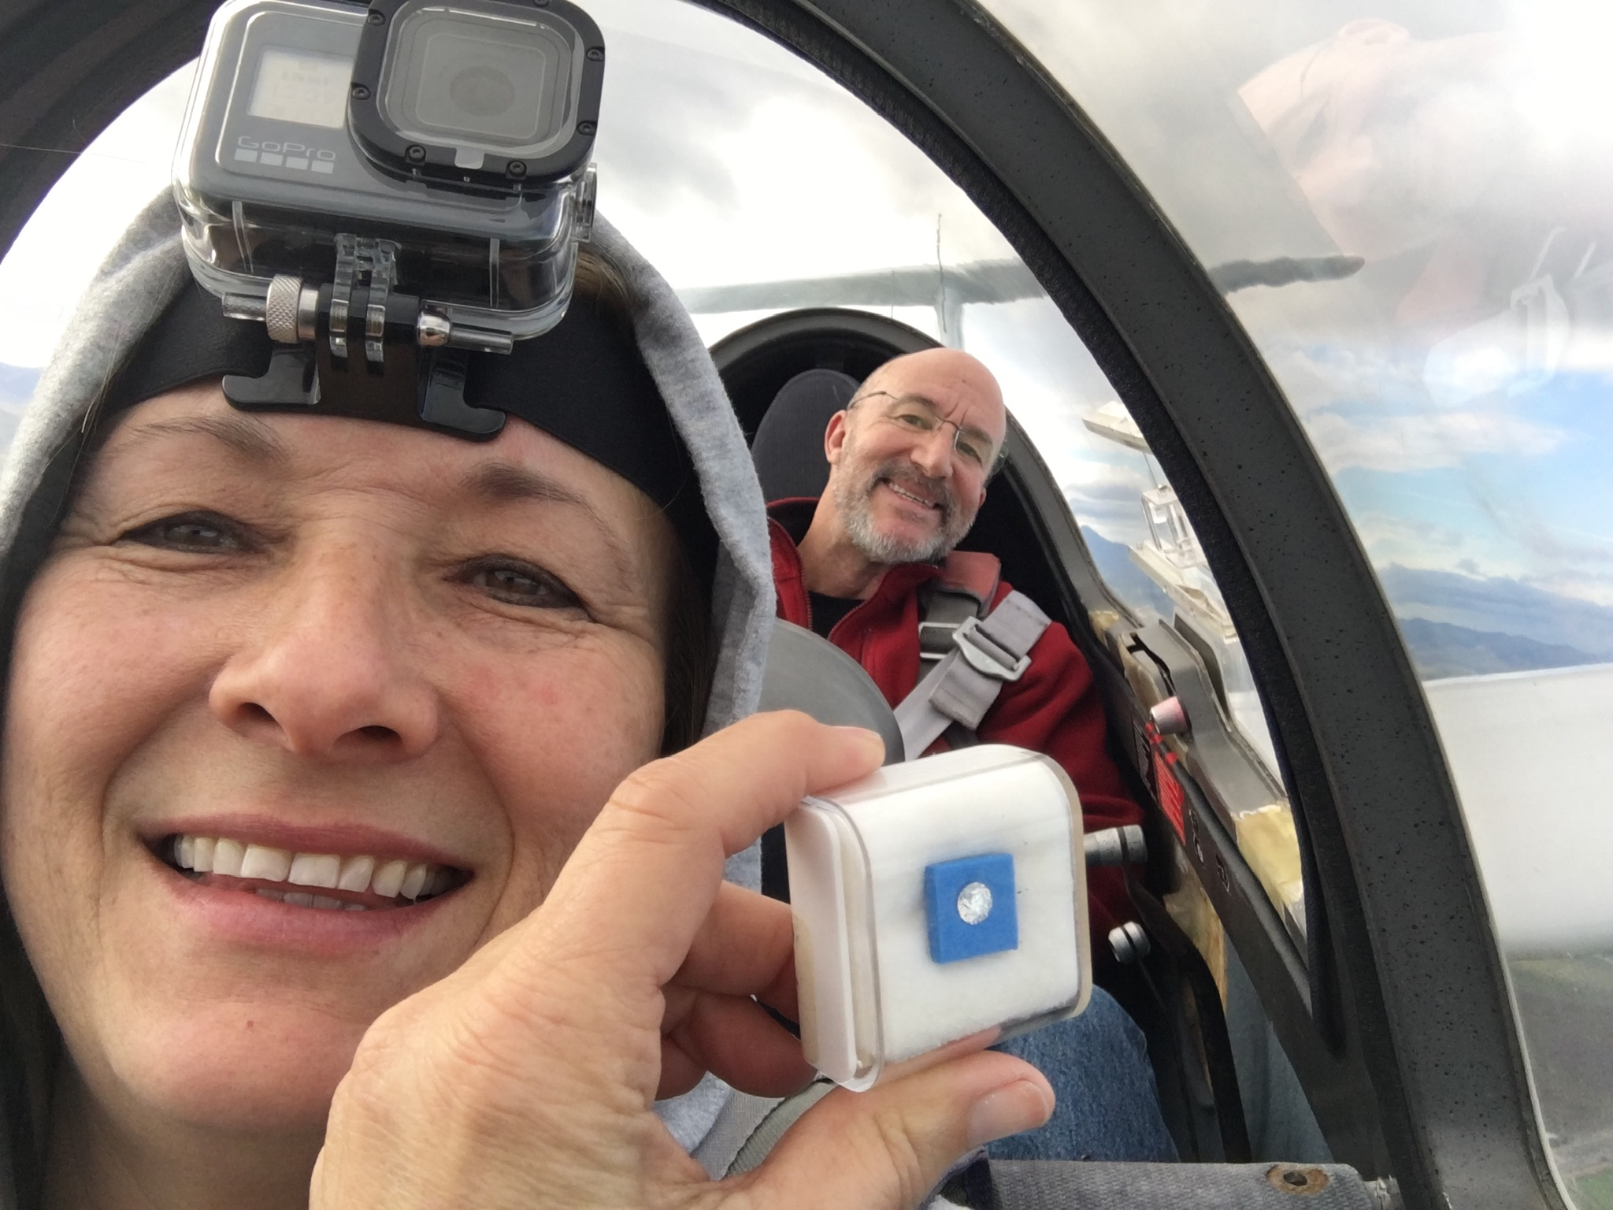
BESTS/MEMORABLE in 2019
Last, but not least, the winning answer for Best/Most Memorable goes to
Craig Payne
Popping the question in a glider!

Slide 26
Contests in 2019
Ramy- DDD (Dust Devil Dash straight out distance) 1st place
Mike M- CD for the Region 11 contest at Truckee

Slide 27
Goals for 2020
Michael Demeyer- Get current and competent after a 40-year lapse. Attend the Air Sailing Thermal Camp in June (already registered) to begin to get some Sierra soaring experience.
Ramy- Fewer landouts
Dan C- Complete gold badge with 300 km declared task.

Slide 28
Goals for 2020
Mike M- Do a good job of CD for the Region 11 contest at Truckee; Fly more.
John Boyce- Staying safe, sane and having fun in 2020
Tom A- Just enjoy flying my ASW-20

Slide 29
Goals for 2020
Paul L- Go further.
Montek- Get my PPL!

Slide 30
Member Achievements and Milestones in 2019
2019 OLC Numbers
Awards and Recognition

Slide 31
TOTAL GLIDER CROSS-2019 OLC COUNTRY KM
Andrew Chant 347
Brent Davidson 380
Willie Snow 525
Paul Lowenstein 716
Sergey Kataev 781
Ace Lewis 901
Peter Rusko 1103
Van Henson 1112

Slide 32
TOTAL GLIDER CROSS-2019 OLC COUNTRY KM
Tom Anklam 2881
Dan Colton 2932
Brian Roach 3072
Mike Mayo 4091
Larry Suter 4282
Alex Neigher 4857
Buzz Graves 6712
Ramy Yanetz 36718

Slide 33
TOTAL NUMBER OF OLC FLIGHTS 2019
Paul Lowenstein 2
Andrew Chant 3
Brent Davidson 3
Sergey Kataev 4
Willie Snow 6
Peter Rusko 7
Van Henson 7
Ace Lewis 9

Slide 34
TOTAL NUMBER OF OLC FLIGHTS 2019
Mike Mayo 13
Dan Colton 18
Buzz Graves 21
Larry Suter 23
Tom Anklam 24
Brian Roach 25
Alex Neigher 36
Ramy Yanetz 65

Slide 35
TOTAL GLIDER HOURS- 2019
(larger of OLC or reported)
Willie Snow 12*
Roy Moeller 12
Brent Davidson 13*
Montek Sethi 16
Ace Lewis 19*
Sergey Kataev 20*
Van Henson 20*
Peter Rusko 24*
*OLC only

Slide 36
TOTAL GLIDER HOURS- 2019
(larger of OLC or reported)
John Boyce 40
Mike Mayo 44* (Not enough)
Val Mayamsin 46
Dan Colton 52
Brian Roach 52*
Tom Anklam 64
Paul Lowenstein 83
Buzz Graves 91*
Alex Neigher 98*
*OLC only

Slide 37
TOTAL GLIDER HOURS- 2019
(larger of OLC or reported)
Larry Suter 113 (66 instruction)
Ramy Yanetz 402
*OLC only

Slide 38
LONGEST FLIGHT (KM) – FROM BYRON 2019 OLC
km
12/28/18 Andrew Chant 50
2/10/19 Dan Colton 77
4/9/19 Alex Neigher 87
12/16/18 Brent Davidson 89
10/6/18 Van Henson 108
12/28/18 Ace Lewis 129
5/1/19 Tom Anklam 145
5/1/18 Brian Roach 148
4/9/19 Larry Suter 157

Slide 39
LONGEST FLIGHT (KM) – FROM BYRON 2019 OLC (cont)
km
8/10/19 Buzz Graves 508
6/1/19 Ramy Yanetz 697

Slide 40
Northern California Soaring Association
Certificate of Achievement 2019
LONGEST FLIGHT FROM BYRON
STANDARD CLASS
Brian Roach
148 km
Byron, CA May 1, 2019

Slide 41
Northern California Soaring Association
Certificate of Achievement 2019
LONGEST FLIGHT FROM BYRON
ADVANCED CLASS
Ramy Yanetz
697 km
Byron, CA June 1, 2019

Slide 42
LONGEST DISTANCE (KM) – ANYWHERE 2019 OLC
km kph
Willie Snow 7/27/19 143 62 KTRK
Brent Davidson 7/20/19 180 43 KTRK
Ace Lewis 5/5/19 248 82 ASI
Andrew Chant 8/3/19 254 72 KTRK
Sergey Kataev 6/11/19 260 54 ASI
Brian Roach 7/12/19 262 86
ASI Peter Rusko 6/13/19 267 67 ASI

Slide 43
LONGEST DISTANCE (KM) – ANYWHERE 2019 OLC
km kph
Van Henson 6/4/19 325 77 ASI
Tom Anklam 8/15/19 347 86 KTRK
Paul Lowenstein 7/28/19 396 76 KTRK
Alex Neigher 7/27/19 419 83 ASI
Dan Colton 7/27/19 446 85 KTRK
Larry Suter 6/14/19 452 115 ASI

Slide 44
LONGEST DISTANCE (KM) – ANYWHERE 2018 OLC
km kph
Buzz Graves 5/11/19 521 94 KCVH
Mike Mayo 7/27/19 538 107 KTRK
Ramy Yanetz 7/11/19 1111 137 Tonapah

Slide 45
Northern California Soaring Association
Certificate of Achievement 2019
LONGEST DISTANCE FLIGHT
STANDARD CLASS
Dan Colton
446 km
Truckee, CA July 27, 2019

Slide 46
Northern California Soaring Association
Certificate of Achievement 2019
LONGEST DISTANCE FLIGHT
ADVANCED CLASS
Ramy Yanetz
1111 km
Tonopah, NV July 11, 2019

Slide 47
LONGEST DISTANCE (KM) – IN A CLUB SHIP 2018 OLC
km
3/23/19 Larry Suter 56 Byron G103
4/9/19 Alex Neigher 87 Byron G102
12/28/18 Ace Lewis 129 Byron G102
5/27/19 Buzz Graves 153 Panoche G103
7/20/19 Brent Davidson 180 Truckee G102
8/3/19 Andrew Chant 254 Truckee G103
6/11/19 Sergey Kataev 260 ASI G103
6/13/19 Peter Rusko 262 ASI G102

Slide 48
Northern California Soaring Association
Certificate of Achievement 2019
LONGEST FLIGHT USING A CLUB SHIP
Peter Rusko
262 km
Grob 102
Air Sailing June 13, 2019

Slide 49
FASTEST AVERAGE X-C SPEED ANYWHERE (OLC Flight >100km)
kph km
7/20/18 Brent Davidson 44 180 KTRK
6/11/19 Sergey Kataev 54 260 ASI
7/27/19 Willie Snow 62 143 KTRK
6/13/19 Peter Rusko 67 267 ASI

Slide 50
FASTEST AVERAGE X-C SPEED ANYWHERE (OLC Flight >100km)
kph km
8/3/19 Andrew Chant 72 254 KTRK
7/28/19 Paul Lowenstein 76 396 KTRK
6/4/19 Van Henson 77 325 ASI
5/5/19 Ace Lewis 82 248 ASI
7/17/19 Dan Colton 85 445 KTRK
8/15/19 Tom Anklam 86 347 KTRK
7/12/19 Brian Roach 86 262 ASI
7/5/19 Alex Neigher 89 292 KTRK

Slide 51
FASTEST AVERAGE X-C SPEED ANYWHERE (OLC Flight >100km)
kph km
6/29/19 Buzz Graves 103 401 KCVH
6/14/19 Larry Suter 114 451 ASI
7/5/19 Mike Mayo 123 469 KTRK
7/5/19 Ramy Yanetz 144 1028 Ely

Slide 52
Northern California Soaring Association
Certificate of Achievement 2019
FASTEST OLC SPEED FOR A FLIGHT
> 100KM
STANDARD CLASS
Alex Neigher
89 kph over 292 km
Truckee, CA July 5, 2019

Slide 53
Northern California Soaring Association
Certificate of Achievement 2019
FASTEST OLC SPEED FOR A FLIGHT
> 100KM
ADVANCED CLASS
Ramy Yanetz
144 kph over 1028 km
Ely, NV July 5, 2019

Slide 54
Member Achievements and Milestones in 2019
Numbers
Awards and Recognition

Slide 55
NCSA Cross Country Perpetual Trophy
Rules:
Only NCSA member’s OLC flights
Pasco’s Sawyer Award’s rules:
-Can only win twice
-Region 11 flights only
-Score based on OLC “points” X (Pilot Factor)
-The Pilot Factor helps level the field for newer pilots and encourage budding XC pilots
  eg- Ramy, Buzz, Mike S PF=0.7
  Mike Mayo, Larry PF=1.0
  Van, Marianne, Willie PF=1.5
  Brent, Ace PF=3.0

Slide 56
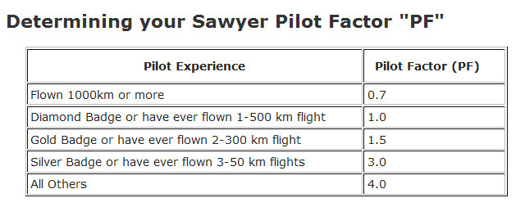
The Pilot Factor gives newer XC pilots a real chance (given that Ramy’s already won it twice)
  eg- Ramy, Buzz, Mike S PF=0.7
  Mike Mayo, Larry PF=1.0
  Van, Marianne, Willie PF=1.5
  Brent, Ace PF=3.0

Slide 57
Order in OLC km flown by NCSA pilots
Ramy 36718
Buzz 6712
Alex 4857
Larry 4282
Mike M 4091
Brian 3072
Dan 2932
Tom 2881
Van 1112
Peter R 1103
Ace 901
Sergey 781
Paul L 716
Willie 525
Brent 380
Andrew 347

Slide 58
This is the order in “points” (km X aircraft factor)
Ramy 34747
Buzz 6217
Alex 4987
Larry 4319
Mike M 4103
Brian 3096
Dan 3042
Tom 2987
Van 1221
Ace 1109
Peter R 1103
Sergey 925
Paul L 743
Willie 608
Brent 418
Andrew 407

Slide 59
The third column shows the all-important Pilot Factor multiplier
Ramy 34747 0.7
Buzz 6217 0.7
Alex 4987 3
Larry 4319 1
Mike M 4103 1
Brian 3096 3
Dan 3042 1.5
Tom 2987 3
Van 1221 1.5
Ace 1109 3
Peter R 1103 4
Sergey 925 4
Paul L 743 1
Willie 608 1.5
Brent 418 3
Andrew 407 3

Slide 60
And the winner is:
Alex Neigher!
PointsxPF
Ramy 24323
Alex 14961
Brian 9287
Tom 8960
Dan 4563
Peter R 4414
Buzz 4352
Larry 4319
Mike M 4103
Sergey 3701
Ace 3328
Paul L 2229
Van 1832
Brent 1254
Andrew 1221
Willie 912

Slide 61
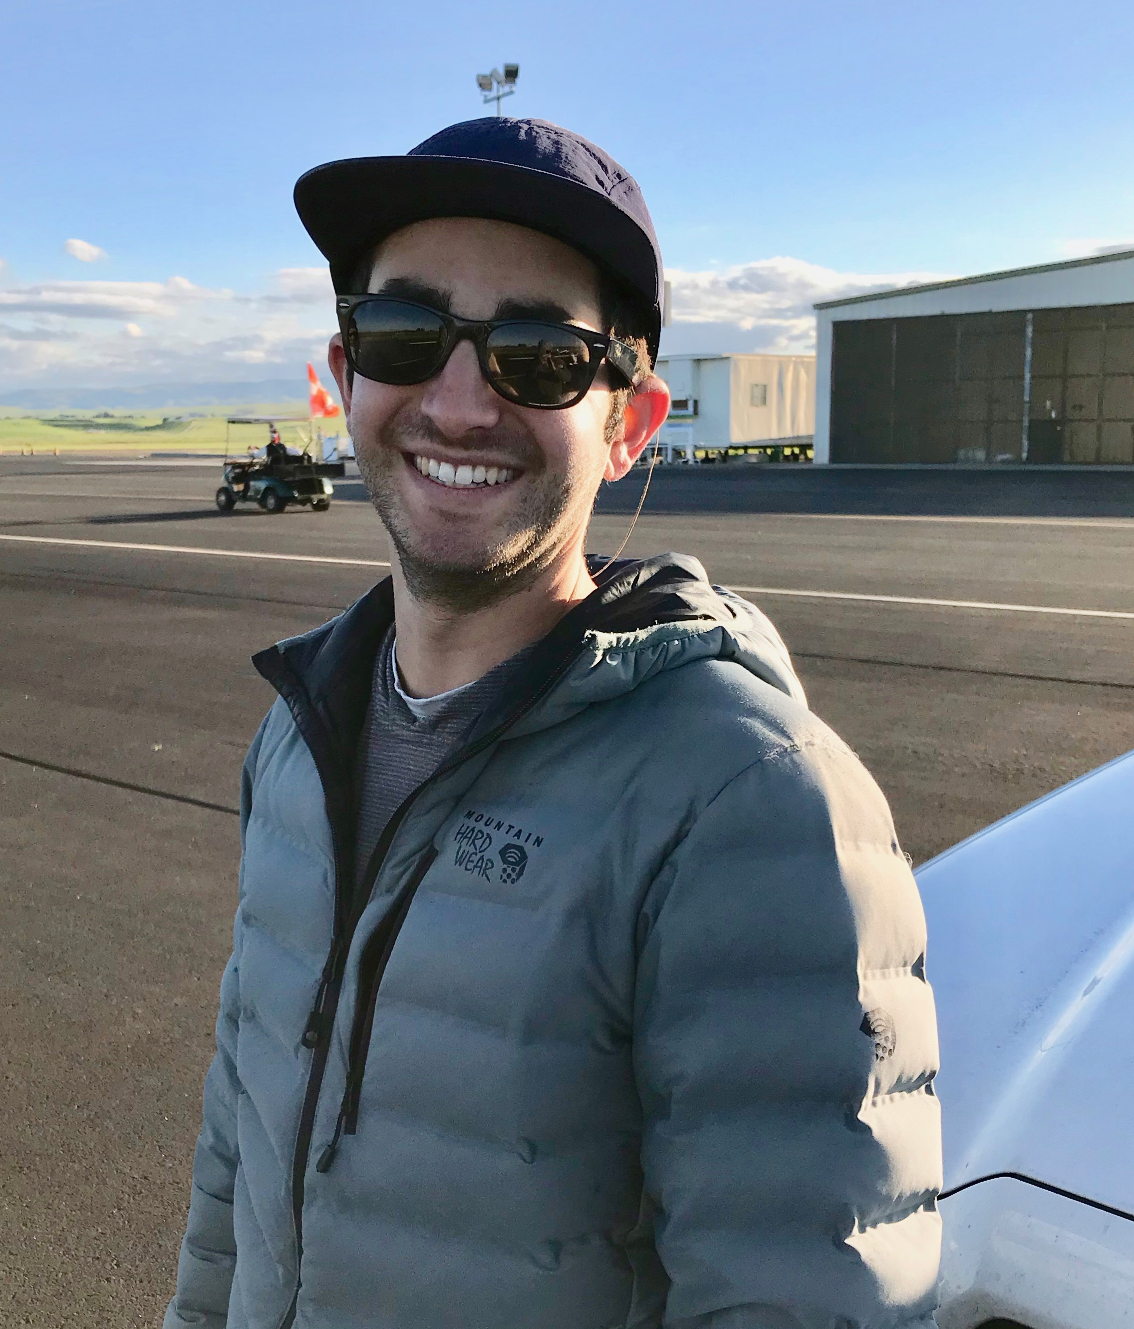
Congratulations Alex!!!!

Slide 62

The Coveted 1-26 Trophy recognizing the longest 1-26 OLC flight in 2019 goes to:
Nobody!
You could have won this with one OLC flight!

Slide 63
MOST IMPROVED PILOT 2019:
Alex Neigher
NCSA checkout
Truckee checkout
XC Award
Fastest speed
Standard Class
XC at 3 sites

Slide 64
Northern California Soaring Association
Certificate of Achievement 2019
MOST IMPROVED PILOT
Alex Neigher

Slide 65
2019 Tow Pilots
Paul MacDonald Chief Tow Pilot
Dave Magaw
Shamim Mohamed
Ed Ott
Dale Roberts
John Scott
John Pericich
Charlie Bellinie

Slide 66
2019 Tow Pilot of the Year:
Charlie Bellenie
(Pictured here on the receiving end)

Slide 67
2019 Spark Plug:
Brian Roach

Slide 68
2019 Flight Instructors
John Boyce
Buzz Graves
John Randazzo
Larry Suter- Chief Flight Instructor
John Pericich
Terence Wilson
Marianne Guerin

Slide 69
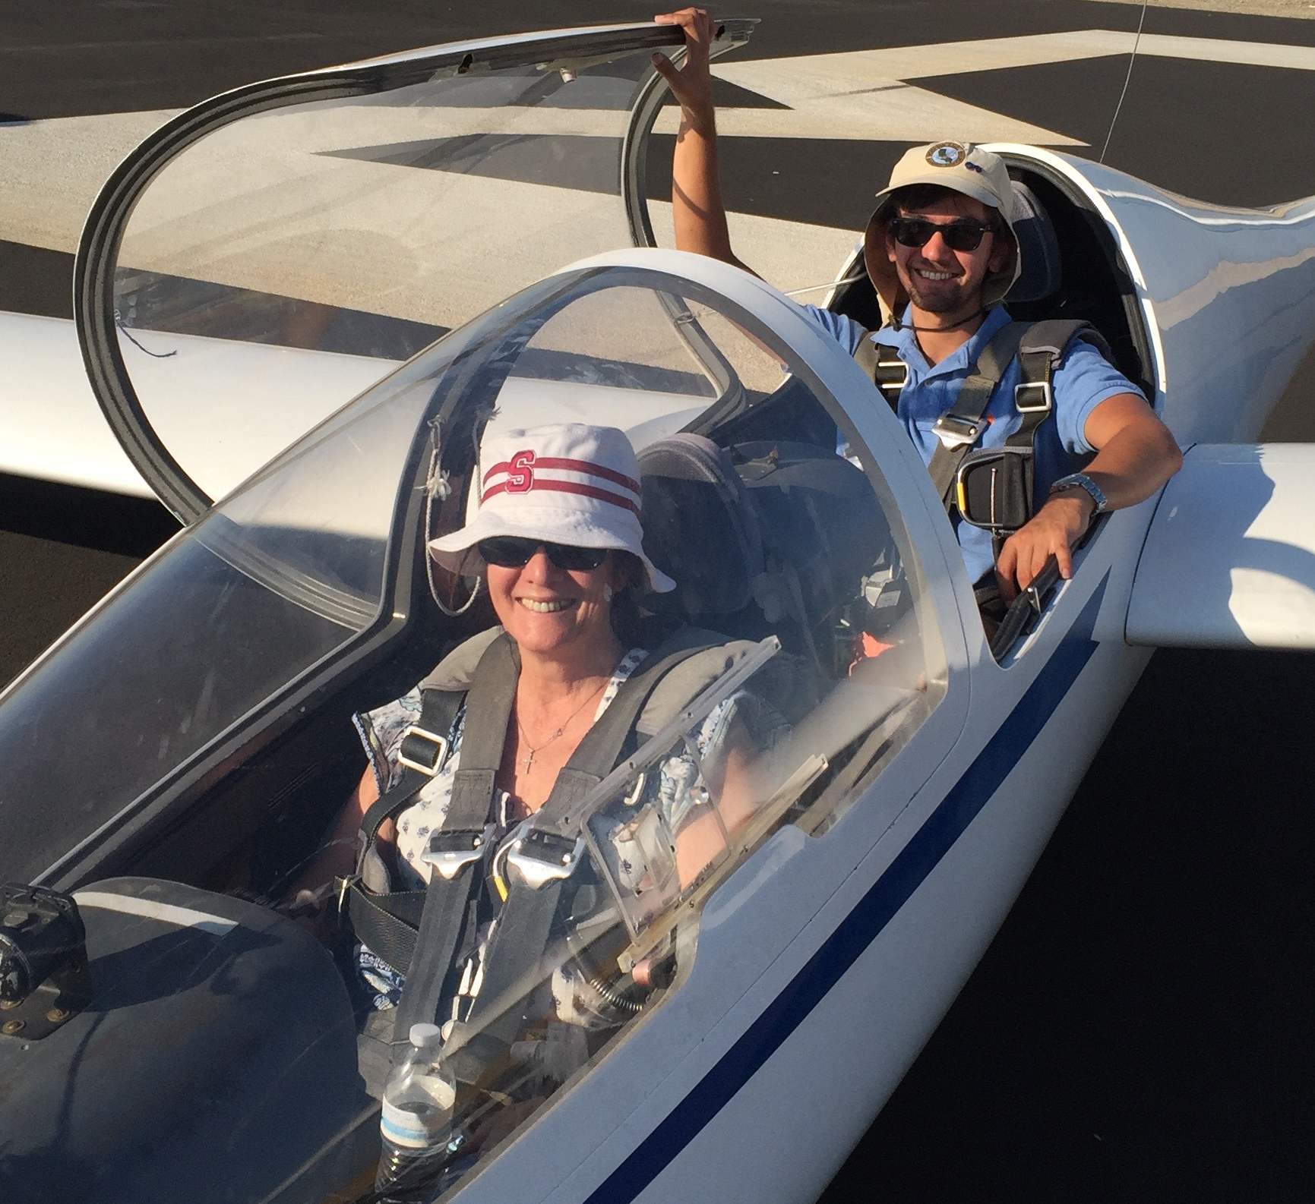
2019 Instructor Of The Year:
John Pericich

Slide 70
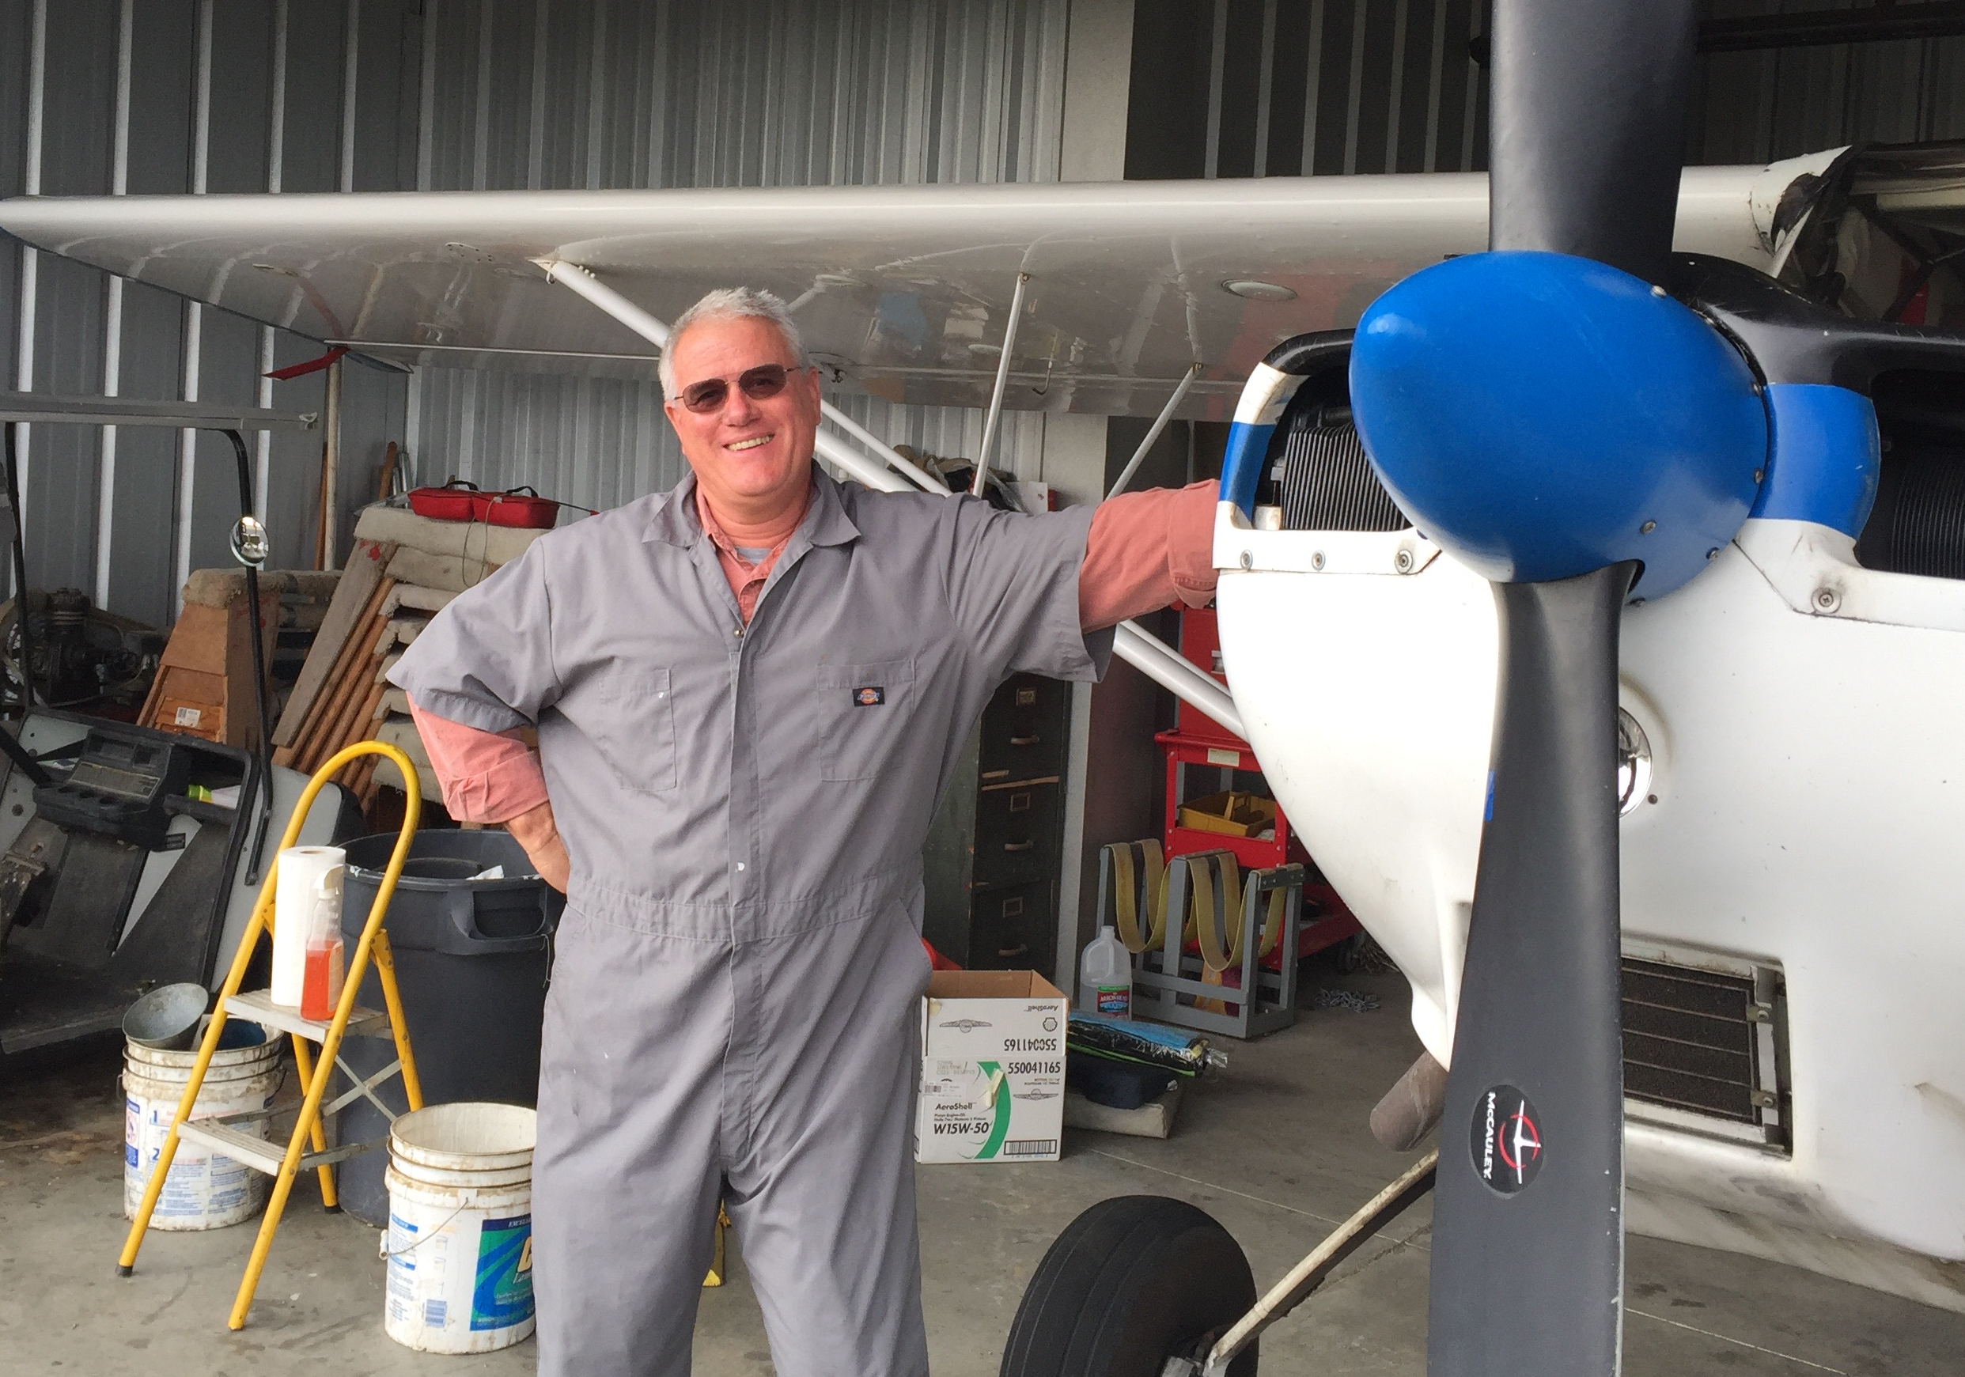
John Scott for serving as 16Y’s Crew Chief
2019 Presidential Award:

