Slide 1
N.C.S.A BUSINESS MEETING/
AWARDS DINNER - 2019

Slide 2
Member Achievements and Milestones in 2018
Numbers
Awards and Recognition

Slide 3
New Glider Ratings or Wings
John P- CFI-G
Paul L- Private Pilot Glider
Van H – Wings Basic Level 6

Slide 4
CHECK-OUTS IN NEW GLIDERS
Dan C- ASW-20C and BASA Junior
Larry- ASW-27
Tobin F- 1-26
Tom A- ASW-20
Paul L- Grob 103, ASW-20C

Slide 5
2018 Camps
Marianne Guerin- Ran 2018 WSPA at Truckee
Buzz Graves- 14th year as mentor at XC Camp
John S- Assistant Director Thermal Camp & Lead Tow Pilot
Larry- Director Thermal Camp, XC camp mentor, WSPA instructor
Peter Rusko- Thermal Camp

Slide 6
2018 Camps
Brian R- Thermal, XC, Sports Class Contest (all as a slave)
Val M- XC Camp, XC Junior Cap at Avenal, Gliderpalooza
Ramy- Parowan, Ely, Tonopah
Mike M- FAI Region 11 contest at Truckee

Slide 7
FLIGHTS AT NEW GLIDER SITES
Val M- Avenal, Truckee, Byron
Dan C- Williams
Melissa K- Byron
Toinie K- Byron
Montek S- Byron
Sunny S- Byron
Van H – Dillingham (Oahu)

Slide 8
BESTS/MEMORABLE in 2018
Brian R- Aerotowing KP to KTRK
Val M- Flying at ASI, Avenal, Truckee in my own glider (what about Byron?)
Tony K- First Lesson! Joining NCSA in December
Melissa K- First Lesson! Being awarded NCSA Scholarship
Dan C- Bought his first glider, ASW-20C “DC”. Flying to within eyesight of Burning Man
Larry Suter-ASI-Hawthorn-ASI in June. Flying with enthusiastic WSPA participants at Truckee. Most ranked our flights among their most memorable.

Slide 9
BESTS/MEMORABLE in 2018
Paul McDonald- Added John P and Charlie Bellenie to the Tow Pilot staff
Ramy- some fantastic flights to San Francisco/Golden Gate are in wave; to Big Sur Coast and Yosemite Valley. Had 7 flights over 1000km, the highest number of 1000km flights I had in a year (2 from Parowan, 4 from Ely, 1 from Truckee). Had my fastest year ever: fastest thermal flight averaging 101mph over 1124km, my fastest 2.5 hours segment at 130 mph and my fastest yearly average speed at 61 mph.

Slide 10
BESTS/MEMORABLE in 2018
Terence- Training John P for his initial CFI checkride, working with Paul L on his private pilot checkride
Tobin F- 1st solo in the 1-26 in a beautiful post frontal day
Tom A- Gave a friend a ride with a 9000’ tow over Mt Diablo (longest tow ever). Although there was zero lift the flight was 1:20 with tow. Friend loved it. The most relaxing flight of the year. Doing long, high flights out of Truckee during the non-smoky parts of the summer. On one flight, I cruised over ASI at around 16K during one of the contests and had a great view of the swarm of gliders far below. Often finished these flights burning off altitude over Lake Tahoe. Sublime.

Slide 11
BESTS/MEMORABLE in 2018
Mike M- Got a 2 seat simulator working; 2nd place in “Grand Prix” day of Truckee contest; staying on the ground in lots of smoke
Ace- watching and listening to a United jet being vectored around me on a Mt Diablo wave day. In the spring I had some good beginners' XC from Byron, heading south.
Paul L- Flight test: Being waved off at 300’. Working weak lift on test to 7700’
Van H – 63-mile (longest yet) final glide (Southern Pine Nuts to ASI); finally (after numerous mediocre visits in both places) got good soaring flights at both Moriarty and Nympsfield, England; had terrific wave flight all around Lake Tahoe with Mike M on cancelled Region 11 contest day

Slide 12
Contests in 2018
Ramy- Participated in last TAGAR Grand Prix, 3rd place in the OLC-USA Champion category;3rd place in the OLC-USA all flights category;5th place in the OLC-USA speed category
Mike M- FAI region 11 contest at Truckee
Van H- flew the region 11 contest at Truckee as “distinguished ballast” with Mike M
Brain R- ASI Sports Class Contest (working as slave)

Slide 13
Goals for 2019
Brian R- still going for 500K!
Val M- more XC flying
Tonie K- solo and get license
Melissa K- solo and get license
Dan C- fly faster, further, safer. Be a crew, get a crew
Larry S- Fly more and fly safely
Mike M- build 3 more simulators and have them used for training

Slide 14
Goals for 2019
Tom A- Fly longer higher. Give more rides. Have fun flying
Ace- I suffered a set-back of free time in the summer and autumn of 2018, so my goal is to get back to Totally Active
Paul L- Get familiar with Truckee and surrounding and do first US glider XC
Van H- Commercial ticket; 500K flight

Slide 15
Member Achievements and Milestones in 2015
2018 OLC Numbers
Awards and Recognition

Slide 16
TOTAL GLIDER CROSS-2018 OLC COUNTRY KM
Jay Jaeckel 19
Eric Noll 48
Walter Friedrich 133
Marton Kun-Szabo 237
Matthew Gast 472
Marianne Guerin 556
Ace Lewis 655
Andrew Chant 655
Brent Davidson 826

Slide 17
TOTAL GLIDER CROSS-2018 OLC COUNTRY KM
Willy Snow 892
Van Henson 1247
Tom Anklam 1729
Dan Colton 1868
Mike Mayo 3091
Brian Roach 3832
Larry Suter 5312
Buzz Graves 9412
Ramy Yanetz 28912

Slide 18
TOTAL NUMBER OF OLC FLIGHTS 2018
Jay Jaeckel 1
Eric Noll 1
Marianne Guerin 2
Walter Friedrich 3
Ace Lewis 8
Andrew Chant 8
Van Henson 8
Brent Davidson 10
Marton Kun-Szabo 11

Slide 19
TOTAL NUMBER OF OLC FLIGHTS 2018
Mike Mayo 12
Dan Colton 13
Willy Snow 15
Matthew Gast 16
Tom Anklam 17
Buzz Graves 28
Brian Roach 30
Larry Suter 35
Ramy Yanetz 51

Slide 20
TOTAL GLIDER HOURS- 2018
(larger of OLC or reported)
Toinie K- 2.6 hrs
Melissa K- 2.8 hrs
Tobin – 4.5
Paul L- 13
Ace- 23
Dan C- 32
Tom A- 42
Mike M- “Not enough”
Brian R- 71
Buzz- 131
Larry S-150
Ramy- 295

Slide 21
LONGEST FLIGHT (KM) – FROM BYRON 2018 OLC
km kph
3/4/18 Walter Freidrich 37 25
2/11/18 Brent Davidson 47 42
6/17/18 Eric Noll 48 47
5/12/18 Willy Snow 52 70
5/6/18 John Scott 53 58
5/26/18 Matthew Gast 53 46

Slide 22
LONGEST FLIGHT (KM) – FROM BYRON 2018 OLC (cont)
km kph
4/19/18 Tom Anklam 125 35
5/26/18 Van Henson 129 47
5/12/18 Ace Lewis 149 47
4/12/18 Larry Suter 150 60
4/19/18 Brian Roach 152 51
3/25/18 Andrew Chant 156 47
3/4/18 Buzz Graves 465 89
4/19/18 Ramy Yanetz 602 87

Slide 23
Northern California Soaring Association
Certificate of Achievement 2018
LONGEST FLIGHT FROM BYRON
STANDARD CLASS
Andrew Chant
156 km
Byron, CA March 25, 2018

Slide 24
Northern California Soaring Association
Certificate of Achievement 2018
LONGEST FLIGHT FROM BYRON
ADVANCED CLASS
Ramy Yanetz
602 km
Byron, CA April 19, 2018

Slide 25
LONGEST DISTANCE (KM) – ANYWHERE 2018 OLC
km kph
Walter Friedrich 7/19/18 55 43 KTRK
Matthew Gast 4/28/18 73 45 Williams
Ace Lewis 5/12/18 149 47 Byron
Andrew Chant 3/25/18 156 47 Byron
Brent Davidson 9/22/18 187 44 KTRK
Willy Snow 9/2/18 202 68 KTRK
Tom Anklam 7/12/18 216 91 KTRK
Marianne Guerin 6/3/18 298 76 ASI

Slide 26
LONGEST DISTANCE (KM) – ANYWHERE 2018 OLC
km kph
Van Henson 9/3/18 300 107 ASI
Brian Roach 7/15/18 302 79 ASI
Dan Colton 8/16/18 310 84 ASI
Larry Suter 6/3/18 415 85 ASI
Mike Mayo 8/31/18 424 113 KTRK
Buzz Graves 9/3/18 774 134 KTRK
Ramy Yanetz 7/7/18 1158 132 Ely

Slide 27
Northern California Soaring Association
Certificate of Achievement 2018
LONGEST DISTANCE FLIGHT
STANDARD CLASS
Dan Colton
310 km
Air Sailing, NV Aug 16, 2018

Slide 28
Northern California Soaring Association
Certificate of Achievement 2018
LONGEST DISTANCE FLIGHT
ADVANCED CLASS
Ramy Yanetz
1158 km
Ely, NV July 7, 2018

Slide 29
LONGEST DISTANCE (KM) – IN A CLUB SHIP 2018 OLC
km
3/4/18 Tom Anklam 32 Byron G103
9/1/18 Brian Roach 54 KTRK G103
7/24/18 Matthew Gast 63 KTRK G103
7/21/18 Andrew Chant 137 ASI G103
5/12/18 Ace Lewis 149 Byron G102
9/21/18 Larry Suter 148 ASI G103
9/22/18 Brent Davidson 187 KTRK G103

Slide 30
Northern California Soaring Association
Certificate of Achievement 2018
LONGEST FLIGHT USING A CLUB SHIP
Brent Davidson
187 km
Grob 103
Truckee, CA Sep 22, 2018

Slide 31
FASTEST AVERAGE X-C SPEED ANYWHERE (OLC Flight >100km)
kph km
8/10/18 John Scott 56 157 ASI
7/21/18 Andrew C 63 137 ASI
9/2/18 Willy Snow 68 202 KTRK
9/15/18 Brent D 71 107 Avenal
7/21/18 Ace Lewis 78 143 ASI
9/2/18 Brian Roach 90 265 KTRK
7/12/18 Tom Anklam 91 216 KTRK
9/3/18 Marianne G 92 258 ASI
7/14/18 Dan Colton 92 260 ASI

Slide 32
FASTEST AVERAGE X-C SPEED ANYWHERE (OLC Flight >100km)
kph km
7/11/18 Larry Suter 103 269 KTRK
9/3/18 Van Henson 107 300 ASI
8/28/18 Mike Mayo 117 312 KTRK
9/3/18 Buzz Graves 134 774 KTRK
7/5/18 Ramy Yantez 163 1124 Ely

Slide 33
Northern California Soaring Association
Certificate of Achievement 2018
FASTEST OLC SPEED FOR A FLIGHT
> 100KM
STANDARD CLASS
Van Henson
107 kph over 300 km
Airsailing, NV Sep 3, 2018

Slide 34
Northern California Soaring Association
Certificate of Achievement 2018
FASTEST OLC SPEED FOR A FLIGHT
> 100KM
ADVANCED CLASS
Ramy Yanetz
163 kph over 1124 km
Ely, NV July 5, 2018

Slide 35
Member Achievements and Milestones in 2015
Numbers
Awards and Recognition

Slide 36
NCSA Cross Country Perpetual Trophy
Rules:
Only OLC flights where club is NCSA
Pasco’s Sawyer Award’s rules:
-Can only win twice
-Region 11 flights only
-Score based on OLC “points” X (Pilot Factor)
-The Pilot Factor helps level the field for newer pilots and encourage budding XC pilots
  eg- Ramy, Buzz, Mike S PF=0.7
  Mike Mayo, Larry PF=1.0
  Terence, Marianne, Willie PF=1.5
  Brian, Ace PF=3.0

Slide 37
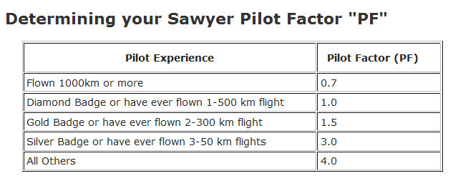
The Pilot Factor gives newer XC pilots a real chance (given that Ramy’s already won it twice)
  eg- Ramy, Buzz, Mike S PF=0.7
  Mike Mayo, Larry PF=1.0
  Terence, Marianne, Willy PF=1.5
  Ace, Brian PF=3.0

Slide 38
Order in OLC km flown by NCSA pilots
Ramy Yanetz 28912
Buzz Graves 9412
Larry Suter 5312
Brian Roach 3832
Mike Mayo 3091
Dan Colton 1868
Tom Anklam 1729
Van Henson 1247
Willy Snow 892
Brent Davidson 826
Ace Lewis 655
Andrew Chant 655
Marianne G 556
Matthew Gast 472
Marton K 237
Walter F 133
Eric Noll 48
Jay Jaeckel 19

Slide 39
But we only count OLC flights attributed to NCSA
Ramy Yanetz 28912
Buzz Graves 9412
Brian Roach 3832
Mike Mayo 3255
Dan Colton 1868
Tom Anklam 1729
Larry Suter 1344
Willy Snow 892
Brent Davidson 816
Ace Lewis 749
Andrew Chant 655
Matthew Gast 472
Walter Friedrich 133
Eric Noll 48
Jay Jaeckel 19
Marton Kun-Szabo 5
Van Henson 0
Marianne Guerin 0
Tsk-Tsk

Slide 40
This is the order in “points” only counting flights listed as NCSA
Ramy Yanetz 26722
Buzz Graves 8725
Brian Roach 3944
Mike Mayo 2100
Dan Colton 2000
Tom Anklam 1874
Larry Suter 1592
Willy Snow 989
Ace Lewis 938
Andrew Chant 842
Brent Davidson 646
Matthew Gast 575
Walter Friedrich 138
Jay Jaeckel 41
Marton Kun-Szabo 8
Eric Noll 50
Van Henson 0
Marianne Guerin 0

Slide 41
The third column shows the all-important Pilot Factor multiplier
Ramy Yanetz 26722 0.7
Buzz Graves 8725 0.7
Brian Roach 3944 3
Mike Mayo 2100 1
Dan Colton 2000 1.5
Tom Anklam 1874 3
Larry Suter 1592 1
Willy Snow 989 1.5
Ace Lewis 938 3
Andrew Chant 842 3
Brent Davidson 646 3
Matthew Gast 575 3
Walter Friedrich 138 1
Jay Jaeckel 41 4
Marton Kun-Szabo 8 3
Eric Noll 50 4
Van Henson 0 1.5
Marianne Guerin 0 1.5

Slide 42
And the winner is:
Brian Roach!
PointsxPF
Ramy Yanetz 18705
Brian Roach 11831
Buzz Graves 6107
Tom Anklam 5622
Dan Colton 2999
Ace Lewis 2813
Andrew Chant 2527
Mike Mayo 2100
Brent Davidson 1938
Matthew Gast 1724
Larry Suter 1592
Willy Snow 1483
Eric Noll 200
Jay Jaeckel 164
Walter Friedrich 138
Marton Kun-Szabo 24
Van Henson 0
Marianne Guerin 0

Slide 43
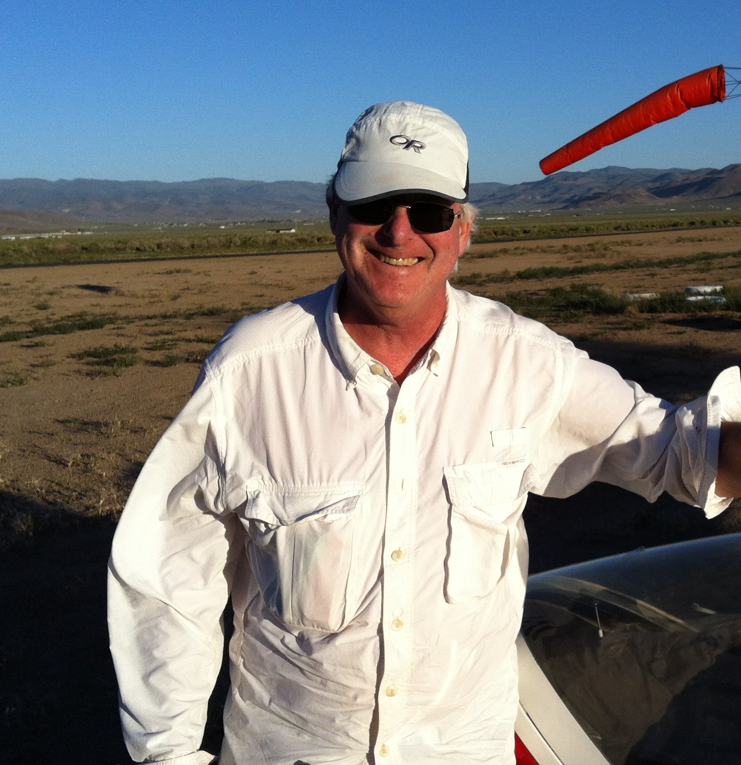
Congratulations Brian!!!!
2X Winner!!!!

Slide 44
Who’ll win next year?
2019 km needed for
PF 12,000 pts
Ramy Yanetz 0.7 17143
Brian Roach 3 4000
Buzz Graves 0.7 17143
Tom Anklam 3 4000
Dan Colton 1.5 8000
Ace Lewis 3 4000
Andrew Chant 3 4000
Mike Mayo 1 12000
Brent Davidson 3 4000
Matthew Gast 3 4000
Larry Suter 1 12000
Willy Snow 1.5 8000
Eric Noll 4 3000
Jay Jaeckel 4 3000
Van Henson 1.5 8000
Marianne Guerin 1.5 8000

Slide 45
The Coveted 1-26 Trophy recognizing the longest 1-26 OLC flight in 2018
Tom Anklam
30 km
Byron
3/23/18

Slide 46
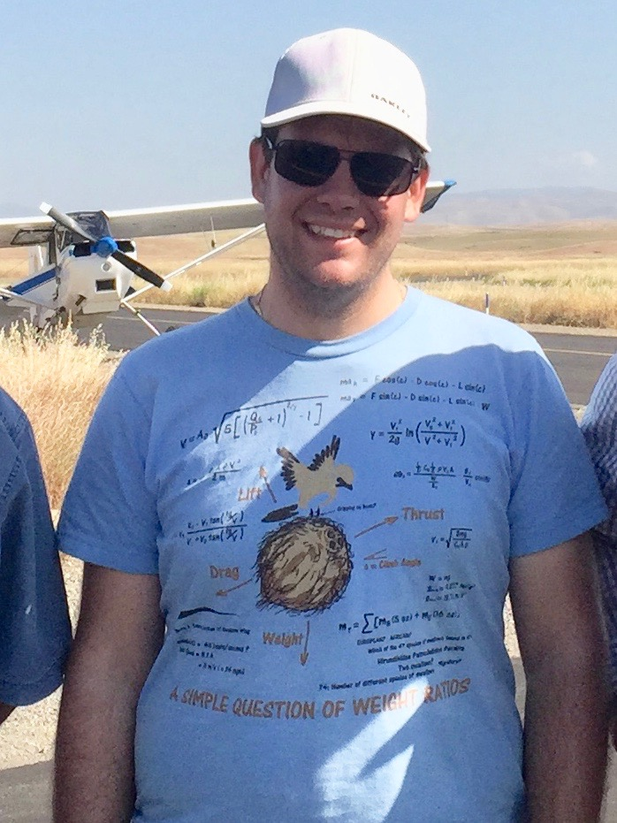
MOST IMPROVED PILOT 2018:
Peter Rusko
Private Pilot rating
Thermal Camp
ASI Checkout
Truckee Checkout

Slide 47
Northern California Soaring Association
Certificate of Achievement 2018
MOST IMPROVED PILOT
Peter Rusko

Slide 48
2018 Tow Pilots
Paul MacDonald Chief Tow Pilot
Dave Magaw
Shamim Mohamed
Ed Ott
Dale Roberts
John Scott
Dean Hickman Smith
John Pericich

Slide 49
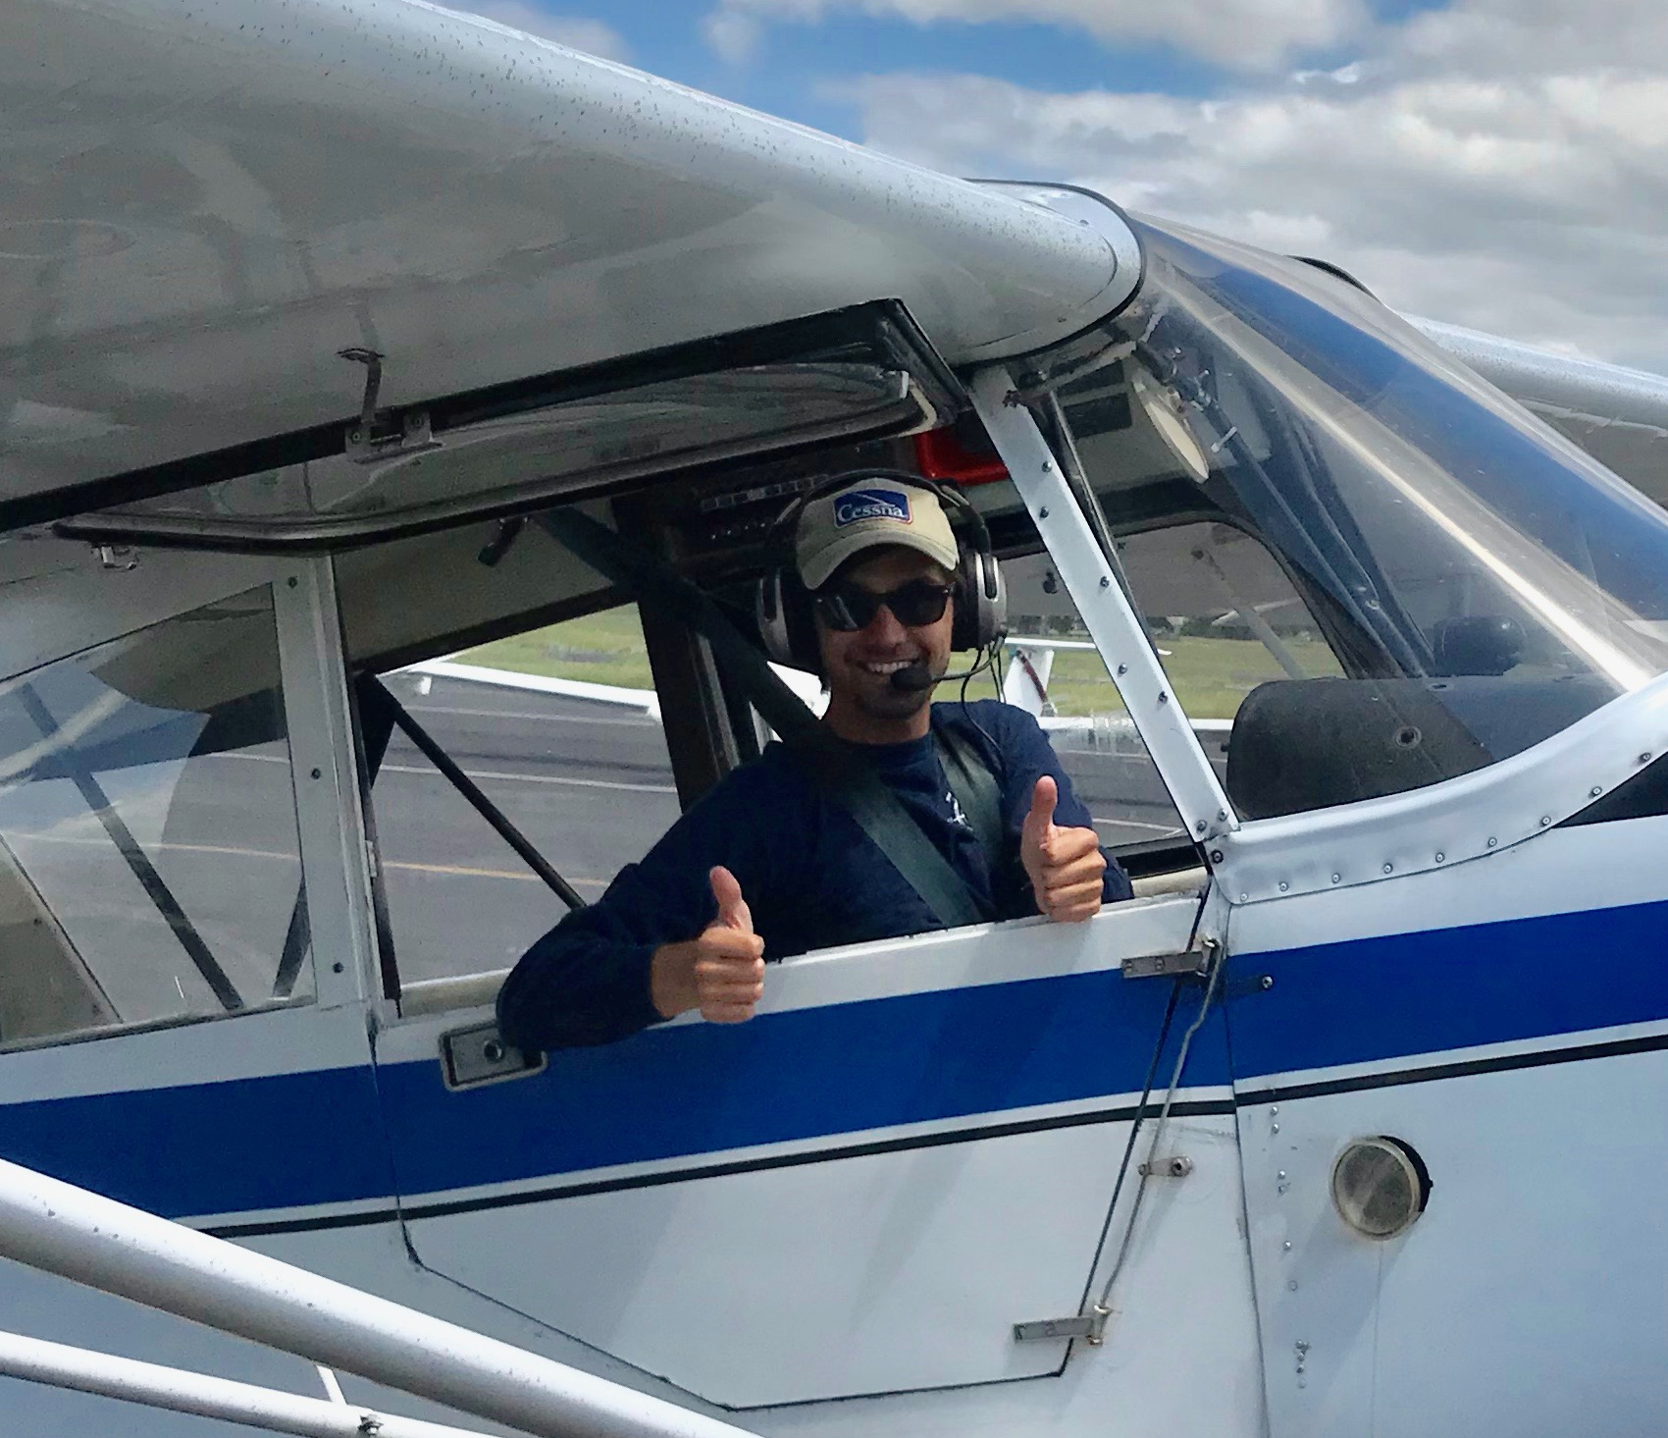
2018 Tow Pilot of the Year:
John Pericich

Slide 50
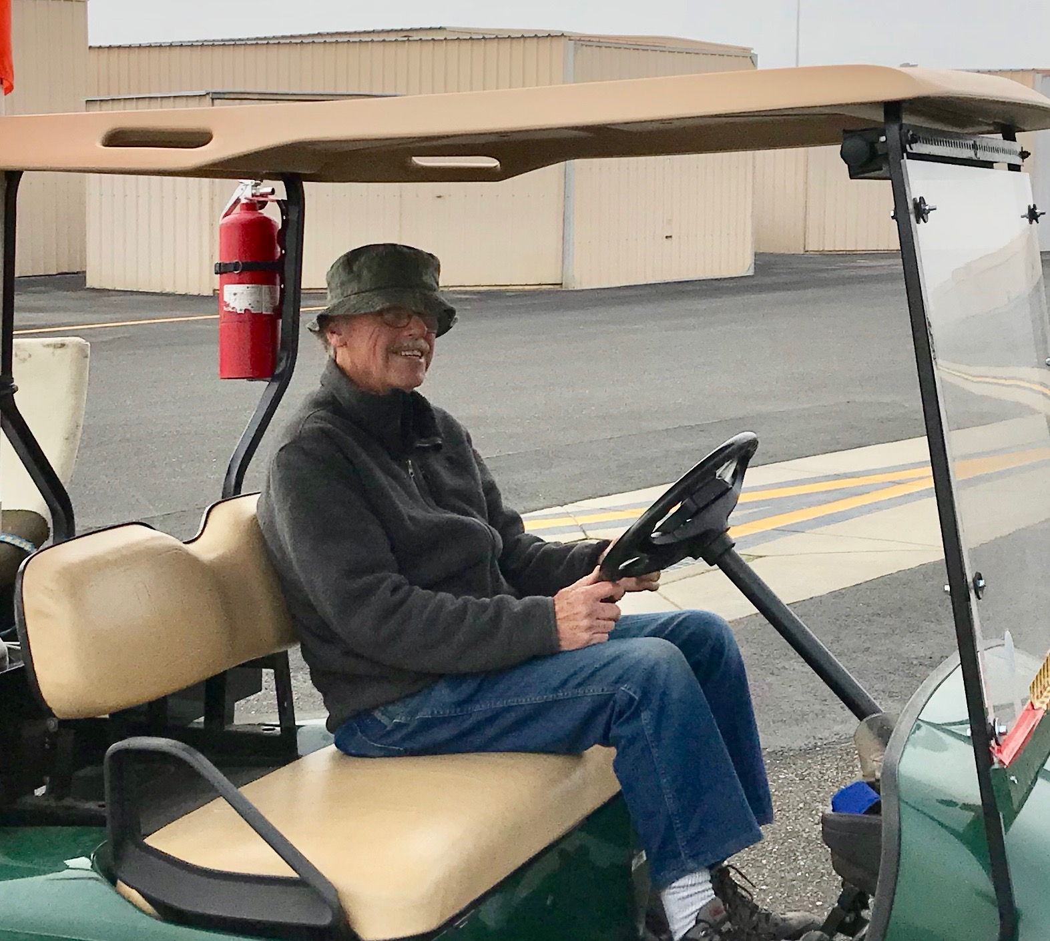
2018 Spark Plug:
Roy Moeller

Slide 51
2018 Flight Instructors
John Boyce
Buzz Graves
John Randazzo
Larry Suter- Chief Flight Instructor
Terence Wilson
John Pericich- New Guy

Slide 52
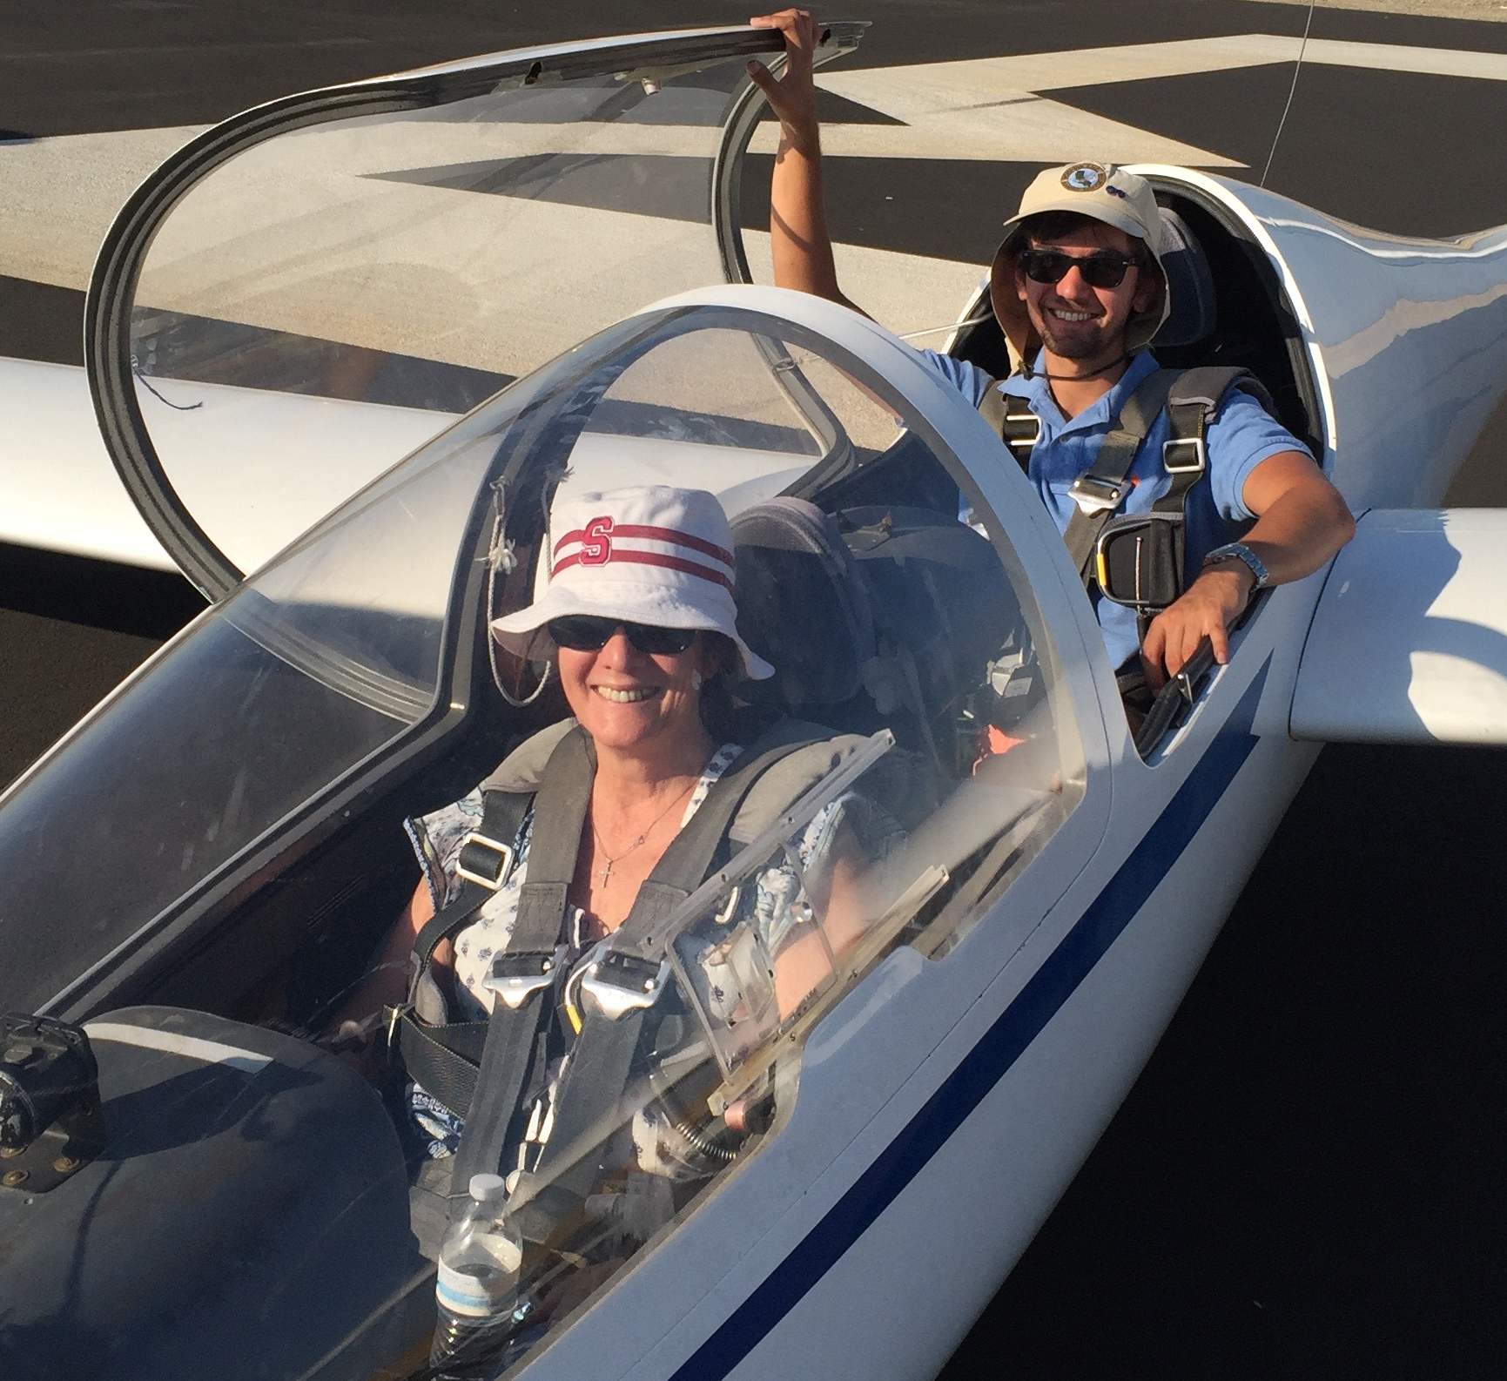
2018 Instructor Of The Year:
John Pericich

Slide 53
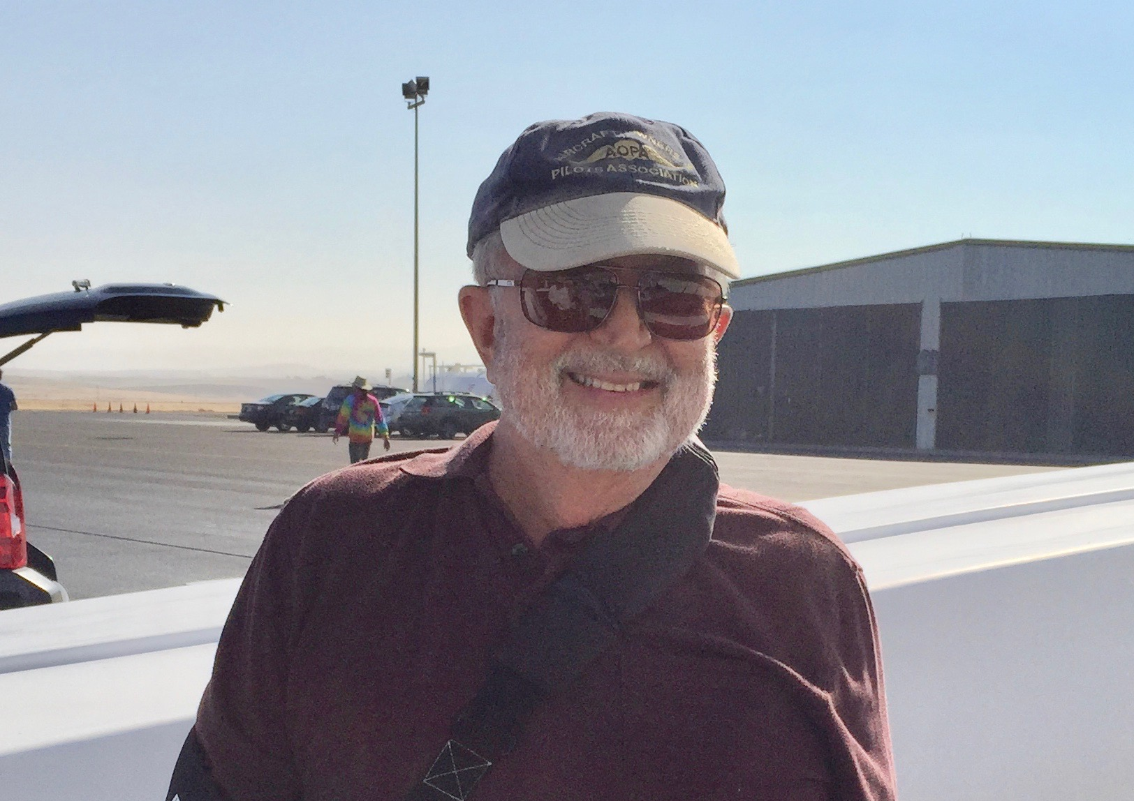
John Randazzo
NCSA Treasurer since
The Beginning of Time
2018 Presidential Award:

