Slide 1
Cross country decisions, soaring forecast and flight planning from Byron
Ramy Yanetz
Jan 2016

Slide 2
It’s OK to land out!
From a recent article in soaring:
“What I am about to say is probably the most important thing to new pilot who want to transition to XC: It’s OK to land out! Seriously – It’s almost one of the best parts of the sport!”
Willing and ready to accept the risk.

Slide 3
Three Simple Land out Plans
Plan A
  Only consider landing at airfields you can aero tow from, then fly airport to airport
Plan B
  Only consider airfields and known good strips and fields
Plan C
  Rely on your abilities to pick a good field from the air in real-time, most advanced, more common in some places

Slide 4
The Landout - off airport
At 1000ft you should be at your LZ.
wind, slope, obstacles, backup plan determined
Fly around your field as you start your approach. View from all sides.
Look for poles, you likely won’t see power lines
Look for fences or lines of taller weeds, dirt built up
Slope? Land uphill. Favor uphill over into the wind in most cases.
Other risks? Squirrel holes, livestock, pipes, obstacles

Slide 5
Ground Base Exercise
Always be scouting landout locations
Driving along look at fields.
  Could I land here?
  How would I approach?
  Slope? Prevailing winds? Obstacles

Slide 6
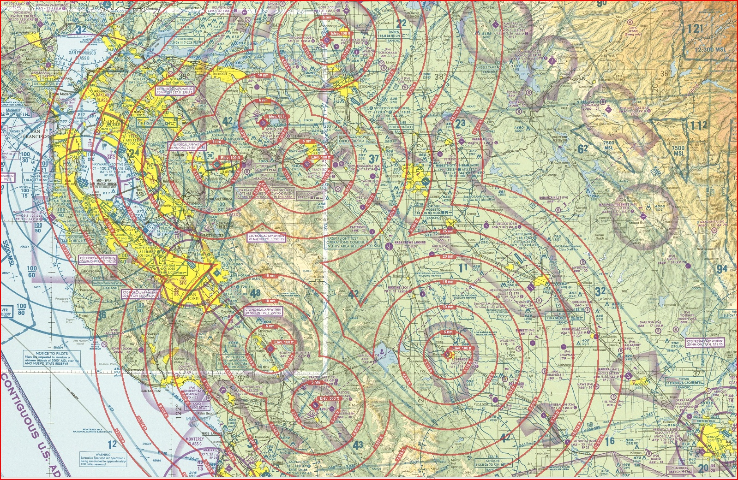

Byron landout options
Aerotowable
Tracy
New Jerusalem
Rio Vista
Los Banos
Hollister
Livermore
Concord
Nut Tree
Other good airports/strips
Reid Hillview
Meadowlark
San Antonio Valley
Santa Nella
South County

Slide 7
Snapping the Rubber Band
Anxiety
  It’s normal
  Minimize, don’t try to eliminate
    Skills
    Weather and forecasting
    Retrieve options

Slide 8
Challenges
Extremely brain intensive
High rate of decision making over long periods
Complex chess game
Requires thinking multiple moves in advance
Always having backup plans
Situational awareness and observation

Slide 9
Leaving the nest
Head out a little bit.
Get a thermal, head a little farther, no thermal, come back.
If one path doesn’t work, try something different.
At some point, you will be unable to glide straight back to Byron. You’re now going XC.
Losing glide to Byron is snapping the rubber band.
There is a freedom that comes with being beyond glide of the home airport. Enjoy it. Settle into the rhythm.

Slide 10
Planning
Have routes in mind, scope them out
Weather - pick a good day, don't wait for epic
  clouds? great!
  lift to 7k in the mountains, 5k in the valley
  light winds, decent convergence forecast
Peers - fly when others are flying
Coordinate retrieve buddies
Launch time? turn around time if coming back?
Goals? Minimums? Successful Outcomes?

Slide 11
Planning (continue)
Check the forecast carefully and frequently
    NAM and RASP Blipmaps available up to 3 days
    Don’t forget to check again in the morning before flight
Be ready early. Timing is everything.
Choose best route for the forecast
Look for unusual soaring conditions and landout options to plan new routes and unusual flights
Contingency planning, be flexible.
Be prepared for landout, carry spot/Inreach
Plan according to forecast, fly according to weather

Slide 12
Check forecast
NWS Forecast discussion
  http://www.wrh.noaa.gov/mtr/forecast.php
  Area forecast discussion (click on AFD)
  Zone: East Bay Hills and Diablo Range
  Check the 1km satellite image in the morning
NAM blipmap - most useful and reliable parameters:
  BL Top
  Cu Potential
  Cu cloudbase
  Total cloud cover
  BL Wind
RASP most useful and reliable parameters:
  Convergence
  Average H-Crit/BLTop
  Wave parameters (vertical velocity 850/700/500 and cross sections)

Slide 13
BlipMap NAM model
Available up to 3 days in advance
The most accurate model
Best for checking top of lift (BLTop), cu potential, cloudbase, wind and overcast up to 3 days in advance
Easiest map to read due to best color scale
Tendency to be overly optimistic in the longer term
  If it indicates conditions which looks to good to be true, it probably is
  If it indicates poor weather, it will most likely be true
Inaccurate for the valley, Unless it is a post frontal unstable day.
Map refreshes every 6 hours
last run is the 9hrs forecast

Slide 14
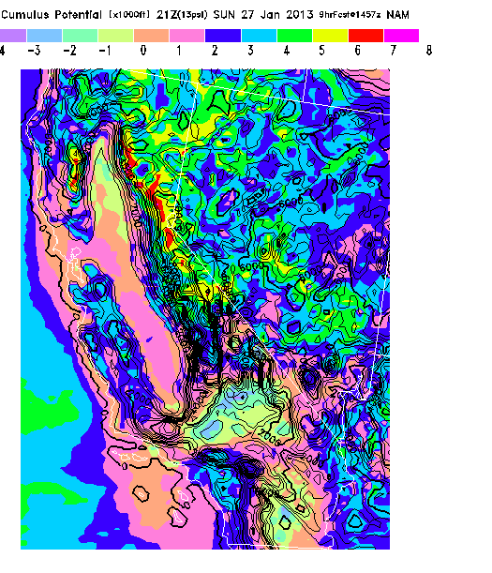
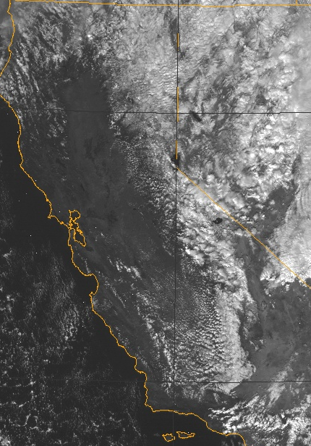
Notes:
Comparison between cu potential prediction showing high potential for cu along the Diablo range, mendocinoes and likely OD over the Sierras, vs actual

Slide 15
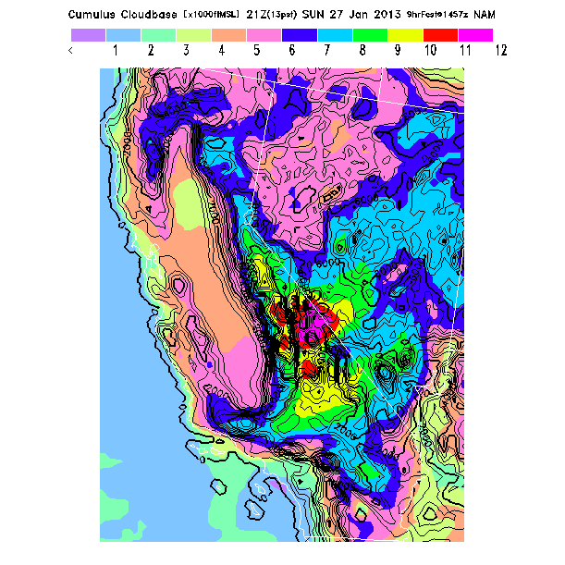

Slide 16
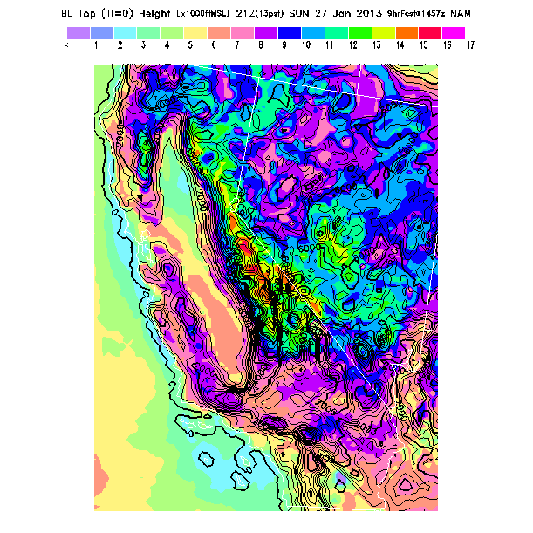

Slide 17
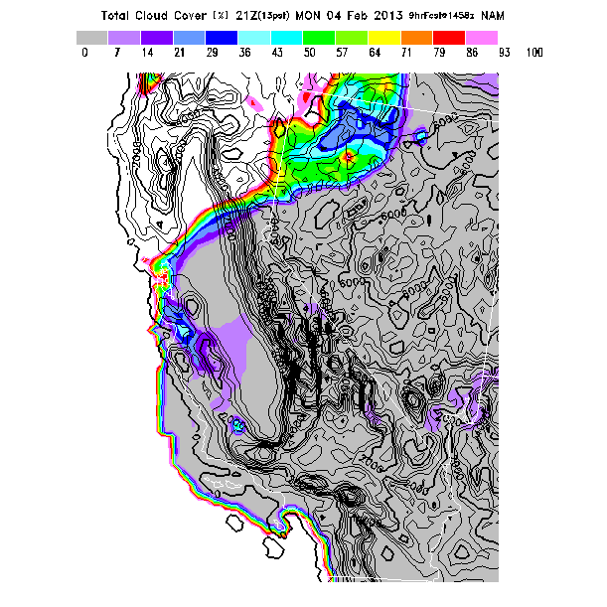
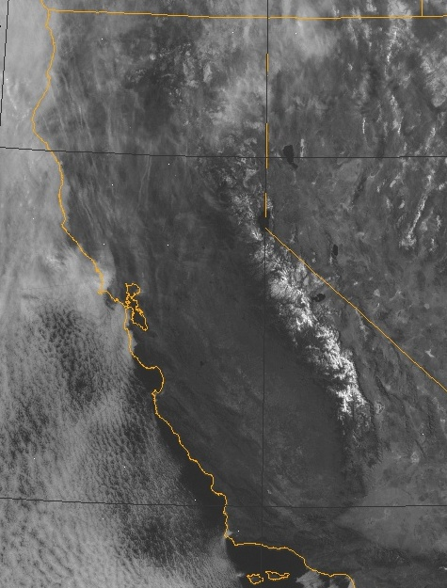
Notes:
Comparison between actual to total cloud cover predicting high clouds (cirrus) only over northern part of the state

Slide 18
RASP Blipmaps
Available the prior evening and up to 2 days ahead
Much higher resolution: 3KM and 750m
Best for determining exact area of best lift, convergence (BL Max Up/Down) and wave
BLTop usually overly optimistic, so use Hcrit instead. Less reliable than NAM.
Clouds parameters are not as accurate as NAM. Cu potential is pessimistic while Cu base is optimistic and may indicate best case scenario.
Color contrast usually not as good as NAM
From the above reasons it is best to use RASP for location of lift and NAM for altitude

Slide 19
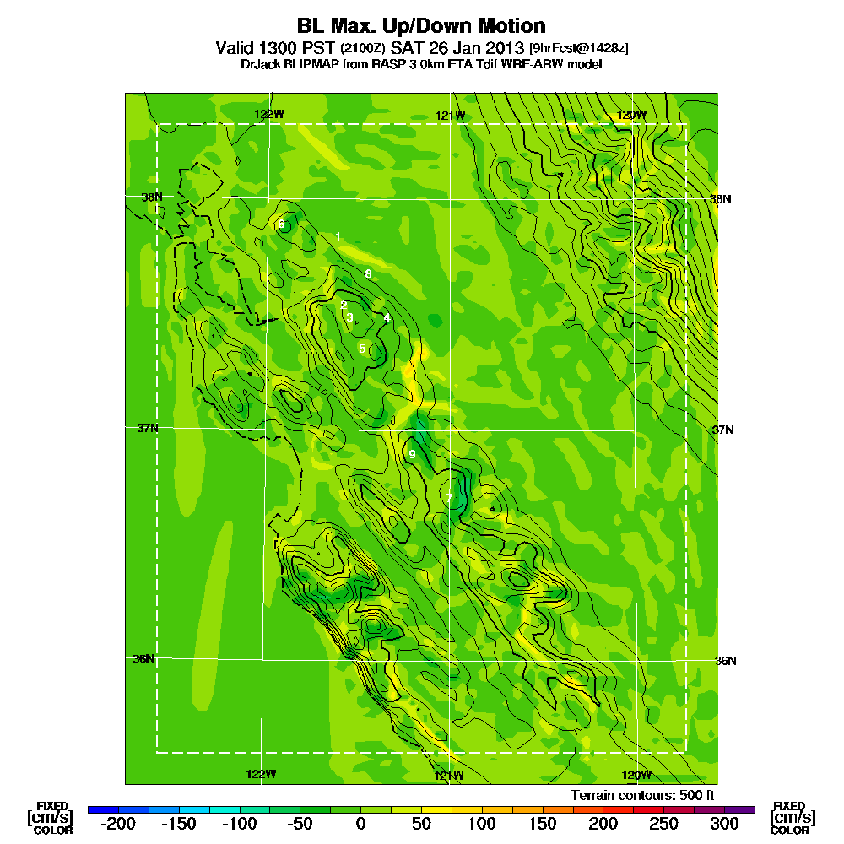

Slide 20
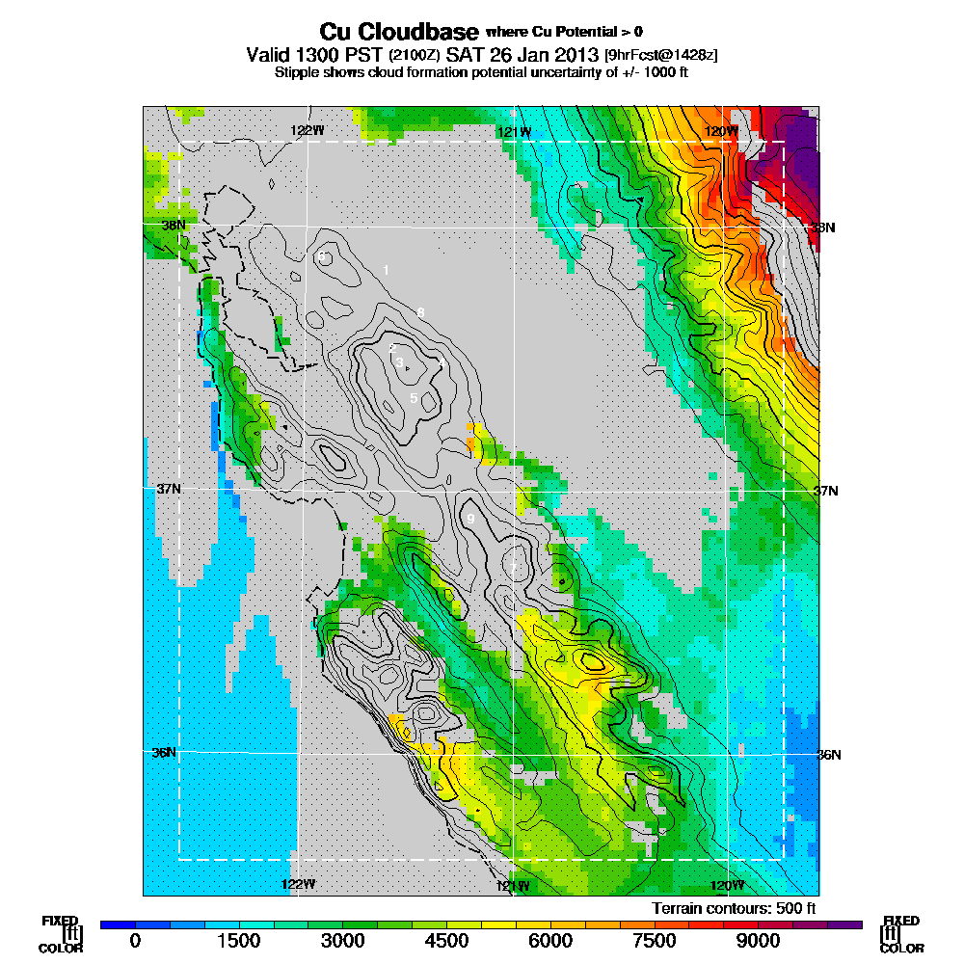

Slide 21
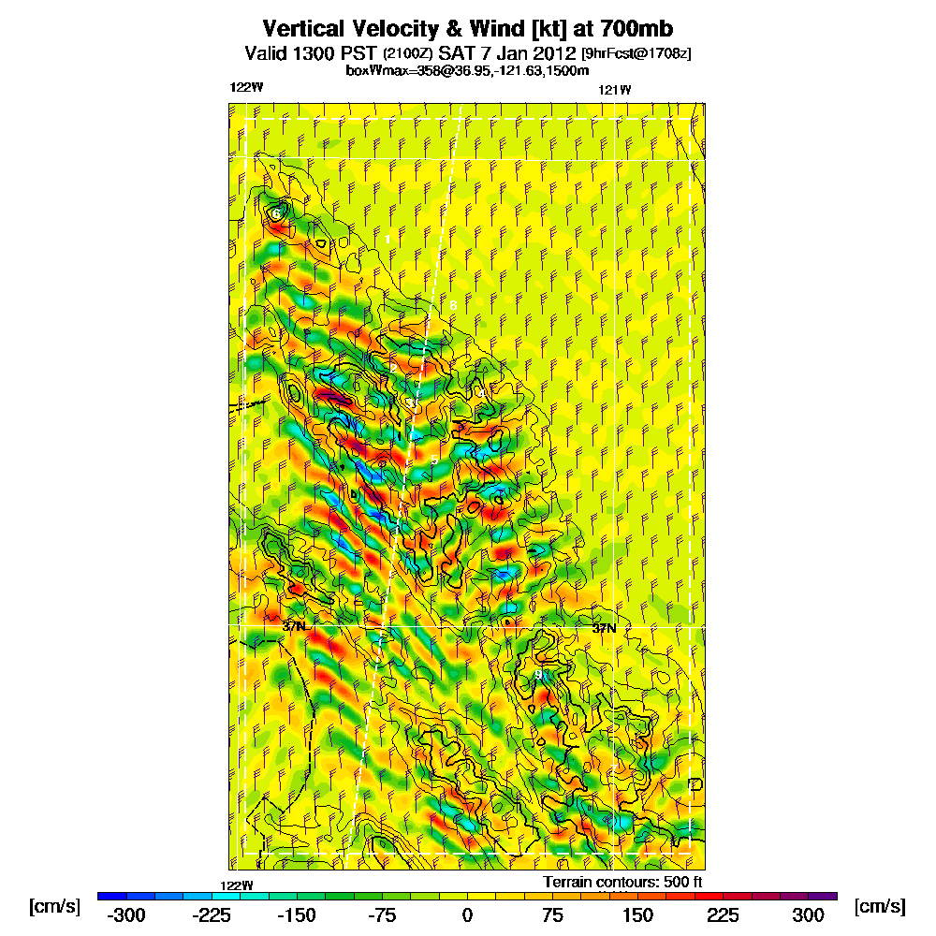

Slide 22
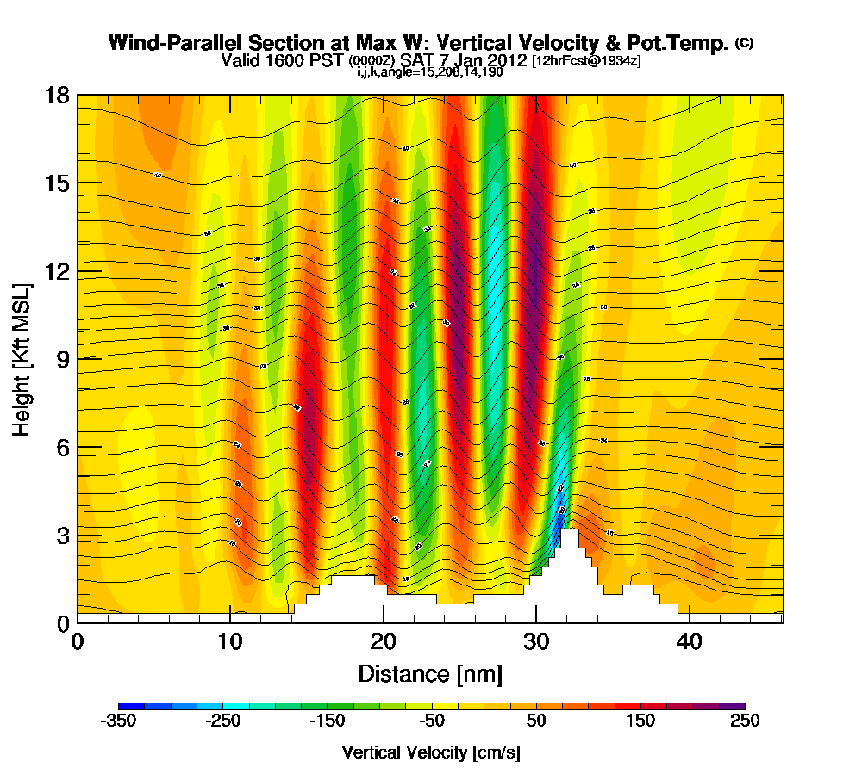
Forecasting wave: Wave cross section
Notes:
22

Slide 23
Forecast (Continues)
Often used but less useful parameters and common mistakes:
  Thermal updraft velocity
  NAM Cu Cloudbase for Cupot > 0
  B/S ratio
  Using RASP instead of NAM
  Fix color instead of classic color
  Not looking at the whole picture

Slide 24
Byron Soaring Potential
In post frontal conditions (typically from Feb to May) the lift is accessible from local low tow and marked with 4000-6000ft cloud bases, providing XC routes to any direction
Great and consistent soaring conditions are only 20 miles away along the Diablo range convergence from March till October
  Often marked with clouds over the San Antonio Valley, persists all day with typical altitude of 6000-8000, occasional 10,000 feet (highest 13,500!).
  Easy glide back to Byron or Tracy from 6000 feet.
  Often requires 20-25 miles 6000-7000ft tow to Rel 1,2 when local lift not presents (20-30 min tow plane round trip)

Slide 25
Byron Soaring Potential
During spring time, The central valley provides safe and easy XC soaring, with plenty of airports and landout fields.
Even during the winter, it is possible to fly XC in post frontal conditions.
The Diablo Range to the south provides excellent convergence soaring year around.
Stable cool marine air is often found west of the convergence. Stable hot air east of the convergence over San Joaquin valley due to strong subsidence and inversion. Strong convergence in the middle over the Diablo ranges due to the different air masses.

Slide 26
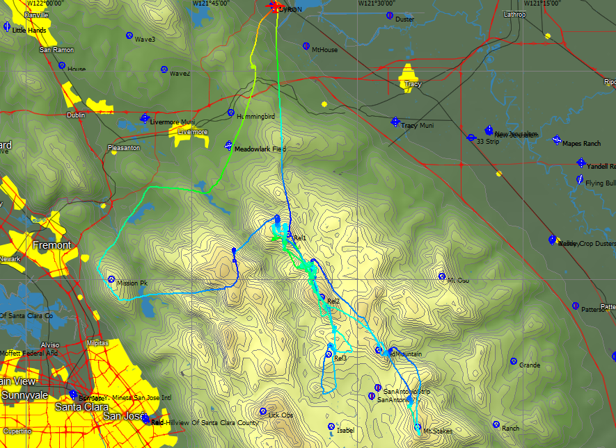
Diablo Range/SAV Release Area
If the lift near Byron does not go above 4000 feet, take a high tow (7000 feet) to the Diablo Range
Tow towards Release 1 (Rel 1) at 70-75 knots so you will arrive there between 6-7000 feet
Release (or stay on tow) and proceed towards Rel 2 along the spine until you find your first lift, usually near Rel 2
If not proceed to Rel 3 and/or to Red Mountain on the edge of the San Antonio valley
The lift is almost always in the area between Rel2,3, and Red Mountain.
Follow the convergence line between red mountain, SAV and Mt Stake
If no lift found head back to Byron before loosing glide (or Tracy if Byron is not in glide).
San Antonio Valley has a good landing strip and good fields

Slide 27
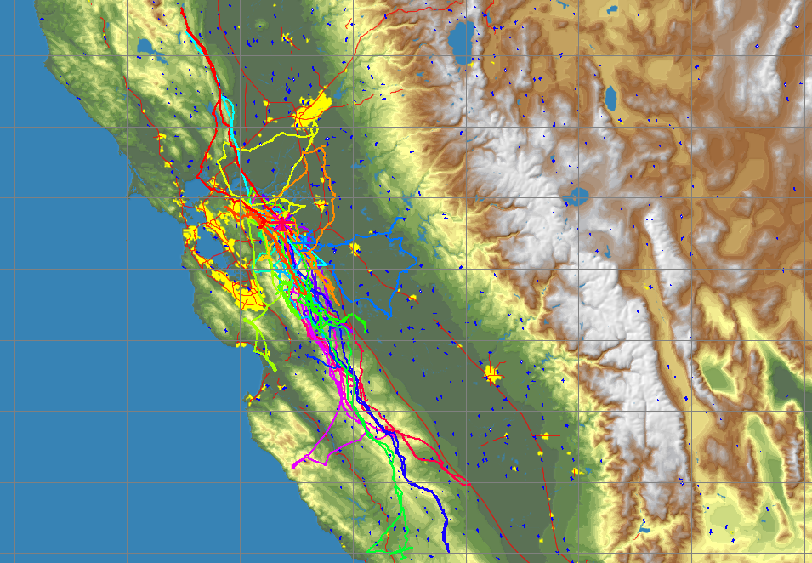
Suggested Tasks from Byron
Silver Badge straight out: Byron to Hollister (100km)
Byron – Pacheco pass – Byron (yoyo): 100 miles
Straight Out to Avenal: 240km
Gold Badge:
Byron– San Benito Mtn (EL4) – Byron: 230 miles (300Km gold dist)
Diamond Badge:
Byron – Hwy41 (South of Avenal) – Byron: 324 miles (500km diamond dist)
Byron – New Cuyama – Byron: 450 Miles (700km)
Byron – Williams/Goat - Byron
Suggested Routes from Byron
North to Mt Diablo and across the delta to Williams only on unstable post frontal days, otherwise poor lift (less frequent)
Best and most common route south along the Diablo range
Often strong convergence marked with clouds over the highest terrain over SAV
When above 7K you can go in the middle, if lower move towards the east side.
When below 4000ft stick to the foothills and Hwy on the east side
Plenty of places to land on the east side, airstrips every 10-15 mls
Unless clouds indicate otherwise, stay towards the east side away from the sea breeze when crossing the Pacheco pass.
Avoid flying too far west or east of the convergence line
Notes:
Byron 2015 traces including 3 wave flights

Slide 28
Byron Wave
Byron wave season Nov-April
Pre frontal wave is best during the hours before the onset of rain with increasing SW winds.
  Pre Frontal Wave can be found anywhere between Byron and Los Vaqueros reservoir
  Often marked with Lenticular clouds or fohen gaps
  XC potential north to Williams and back
North wind wave usually during high pressure off shore wind events
  Requires NNW-NE winds above 20 knots at Mt Diablo
  Usually not marked by clouds
  Wave typically weak (1-2 knots) and very small area (less than 1 square mile) near Wave1 (Diablo) and Wave3 (Los Vaqueros towers)
  Typical altitude 12-18K
  XC potential: North up wind to Napa and Clear Lake, south downwind to Big Sur and beyond

Slide 29
Convergence
Not a continuous line of lift
A line of occasional lift and often much stronger and higher reaching thermals
Follows ridgelines, pushes farther down valleys
Think of water flowing and being divided by ridges
Can be more turbulent. Mixed up, confused thermals
Half up/half down
Little to no wind on the ground
Often can be run along for miles without circling

Slide 30
Debriefing
Debrief every flight, even if it is just mentally
  How would you have improved things?
Debrief Tools
  OLC onlinecontest.org - web
  See You, IGC Replay - PC
Performance parameters
  average climb rate - higher is better
  # thermals - lower is better
  % circling - lower is better
  effective L/D or efficiency - higher is better

Slide 31
Questions?

